Slide 1
The 17th CNS International Summer School
MEAN-FIELD STUDY OF THE RADIATIVE CAPTURE
¹²C(p,γ)¹³N AND ¹³C(p,γ)¹⁴N REACTIONS
Speaker: Le-Anh Nguyen
Supervisor: Prof. Dao Tien Khoa
Ho Chi Minh City University of Education, Vietnam
Institute of Nuclear Science and Technology, VINATOM, Vietnam
25/8/2018
1
Notes:
Good afternoon, everyone!
I’m Nguyen Le Anh, from Ho Chi Minh City University of Education, Vietnam.
Now I’m the master student of Professor Dao Tien Khoa in Institute of Nuclear Science and Technology.
Today, I am here to present to you about the mean-field study of the proton radiative capture of C12 and C13 reactions.
1

Slide 2
CONTENT
Radiative capture
Nuclear mean-field potential
Mean-field description of the ¹²C(p,γ)¹³N and ¹³C(p,γ)¹⁴N reactions
Summary
2
Notes:
My presentation is divided into five parts.
Firstly, I will start with the definition of the radiative capture that means how important the radiative capture processes are in nature.
Then I will look at the nuclear mean-field potential.
Next, the folding model will be also discussed to describe the mean-field of effective NN interaction.
Then, I will present several results on mean-field description of the two reactions.
Finally, there are some conclusion for our study
2

Slide 3
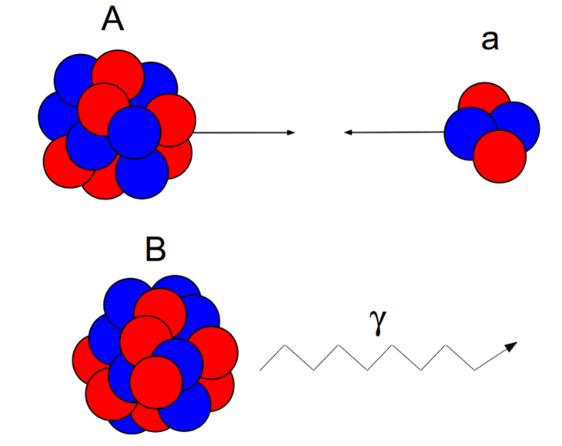
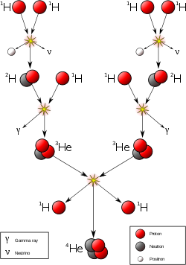
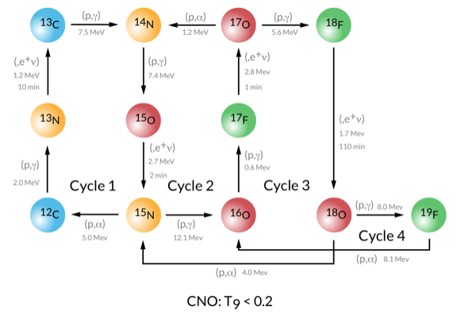
RADIATIVE CAPTURE
Radiative capture is an important process due to its astrophysical applications.
BBN, stellar evolution, element synthesis, X-ray bursts, etc.
CNO cycle
pp chain
Hydrogen burning
3
Notes:
To start, I would like to give you some background information about the radiative capture occurred in the universe.
The nuclear reaction in which the target nucleus captures another nucleus or nucleon and the excitation energy of the nucleus formed is radiated as a gamma quantum.
In fact, radiative capture is an important reaction because of its astrophysical application.
At low energies, radiative capture reactions play an important role in big bang nucleosynthesis, main path stellar evolution, element synthesis or X-ray burst, so on.
There are several radiative capture reactions occurred in the astrophysical processes you can see here. The Hydrogen burning mechanism is essentially the nuclear fusion of four protons into one 4He nucleus. There are two reaction chains that can convert hydrogen to helium, namely the proton–proton (or pp chain) chain, also called pp reaction, and the CNO cycle. The pp chain is more important in stars the mass of the Sun or less and stars of similar mass The CNO cycle by which stars convert hydrogen to helium is the dominant source of energy in more massive stars.
In our study, we investigate two first reactions in the CNO cycle for C12 and C13.
3

Slide 4
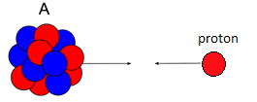
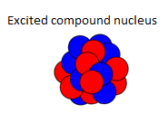
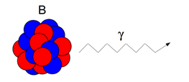
RADIATIVE CAPTURE
Scattering state
Bound state
Direct capture
The radial Schrӧdinger equation:
$$\frac{ℏ^{2}}{2μ}\left[\frac{d^{2}}{dr^{2}}−\frac{l\left(l+1\right)}{r^{2}}\right]u\left(r\right)+V\left(r\right)u\left(r\right)=Eu\left(r\right)$$
Bound state
Scattering state
Coulomb pot.
Nuclear pot.
Spin-orbit pot.
Bound state:
$$u_{J}\left(r\right)→C\exp\left(−k_{B}r\right)$$
Normalization
Scattering state:
$$u_{J}\left(r\right)→F_{J}\left(kr\right)\cos{δ_{J}}+G_{J}\left(kr\right)\sin{δ_{J}}$$
4
Notes:
The nucleon capture can occur two different reaction mechanisms that is direct capture and compound nucleus formation.
In direct capture, a nucleus and incident nucleon (or nucleus) react without a sharing of energy among all the nucleons. An example be the direct radiative capture of a neutron or proton and the immediate ejection of one or more photons. The ejected photons are strongly peaked along the trajectory of the incident projectile. The reaction time is very short.
In the second mechanism, nucleon will bombard to the target nucleus in terms of scattering process, then an excited compound nucleus is formed and finally they in a while drop to lower excitation or ground state.
The main goal is to find the wave functions in the potential model by solving bound state and scattering state systems of the radial Schrodinger equation for a given potential. It is accompanied by normalization condition as shown. The necessary parts of the model are the potential used to generate the wave functions. In this framework, we adopt nuclear potential of folding model.
4

Slide 5
RADIATIVE CAPTURE
Using the balanced detail, the cross section for the radiative capture A(p;γ)B reaction is determined as
$$σ\left(J_{f},E\right)\sim \sum_{σλ}{{\left(\frac{E_{γ}}{ℏc}\right)}^{2λ−1}{\left|\left\langle Ψ^{J_{f}}\left\|M^{σλ}\right\|Ψ\left(E\right)\right\rangle \right|}^{2}}$$
Photon
Nucleon
Matrix elements needed for electromagnetic transitions
Scattering state
Bound state
$$\left\langle Ψ^{J_{f}}\left\|M^{σλ}\right\|Ψ\left(E\right)\right\rangle =eZ_{eff}\left\langle J_{f}λM_{f}μ|J_{i}M_{i}\right\rangle \sqrt{\frac{\left(2J_{i}+1\right)\left(2λ+1\right)}{4π\left(2J_{f}+1\right)}}\int_{0}^{∞}{u_{i}\left(E,r\right)r^{λ}u_{f}\left(r\right)dr}$$
Coupling coefficient
Overlap integral
Long wavelength approximation
$$E_{1}≫E_{2}≈M_{1}≫E_{3}≈M_{2},…$$
$$σλ=$$
5
Notes:
There is no doubt that the cross sections of the reaction are often necessary for investigating the astrophysical entities.
In radiative capture, the cross section for the (p,gamma) reactions are calculated by using the balanced detail as follows
You can see it includes the photon part and the nuclear part.
In the nuclear part, the transition matrix element could be determined as follows. It can be explained as a product of three factors including the angular momentum coupling coefficients and the radial overlap integral between the scattering wave function and bound state wave function.
Finally, the total capture cross section is obtained by adding all multi-polarities and final spins of the bound state.
This S-factor should vary slowly with energy. The first order effects of the Coulomb barrier and Compton wavelength have been factored out.
5

Slide 6
NUCLEAR MEAN-FIELD POTENTIAL
In-medium
NN interaction
Free
NN interaction
HF
BHF, DBHF
NUCLEAR MEAN FIELD
NUCLEAR MATTER
FINITE NUCLEI
EOS of nuclear matter
Single particle potential
Symmetry energy
Neutron star
Bound problems
Scattering problems
Ngo Hai Tan et al, Phys. Rev. C 93, 035806
Doan Thi Loan et al, Phys. Rev. C 92, 034304
Radiative capture
Dao T. Khoa et al, Phys. Rev. C 94, 034612
6
Notes:
The nucleon mean-field potential or single-particle potential is the most important quantity determining the single-particle properties of neutrons and protons in the nuclear matter as well as in the finite nuclei, and it has been the focus of recent many-body studies of the nuclear matter, like Brueckener-Hartree-Fock calculations of the nuclear matter starting from a realistic choice of the free nucleon-nucleon interaction or the mean-field studies of the nuclear matter on the Hartree-Fock level, using the different version of the effective (in-medium) nucleon-nucleon interaction.
An interesting aspect of the single-particle potential is related to the nuclear symmetry energy, an important quantity for the equation of state of asymmetric nuclear matter like neutron star.
In addition, for finite nuclei, the nuclear mean field is applied to solving bound problems and scattering problem. Mean-field theories have successfully been applied to the nuclear structure problems, in particular for stable nuclei. They are also useful to investigate basic characters of the effective interactions.
In this framework, we use nuclear mean-field potential applying to the radiative capture problem.
6

Slide 7
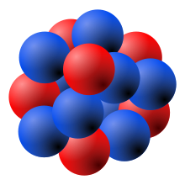
NUCLEAR MEAN-FIELD POTENTIAL
Antisymmetry of wave functions
(Slater’s determinant)
HF Approximation
$$v=v^{D}+v^{EX}$$
Fermions
M3Y
In-medium (density dependent) NN interaction
$$v^{D\left(EX\right)}\left(ρ,s\right)=F_{0}\left(ρ\right)v_{00}^{D\left(EX\right)}\left(s\right)+F_{1}\left(ρ\right)v_{01}^{D\left(EX\right)}\left(s\right)\vec{τ_{1}}⋅\vec{τ_{2}}$$
$$s=\left|{\vec{r}}_{1}−{\vec{r}}_{2}\right|$$
with
Density dependence
G-matrix based on M3Y interaction
D.T. Khoa, G.R. Satchler and W. von Oertzen, Phys. Rev. C 56, 954 (1997);
D.T. Loan, B.M. Loc, and D.T. Khoa, Phys. Rev. C 92, 034304 (2015).
N. Anantaraman, H. Toki, G.F. Bertsch, Nucl. Phys. A 398, 269 (1983).
HvH theorem
HF calculation
Extended HF (HF + RT) calculation
Doan Thi Loan, Bui Minh Loc, and Dao T. Khoa, Phys. Rev. C 92, 034304 (2015)
Dao T. Khoa, Nguyen Hoang Phuc, Doan Thi Loan, and Bui Minh Loc, Phys. Rev. C 94, 034612 (2016)
7
Notes:
Due to the system include all fermions which wave functions are antisymmetric, so HF approach is given by the direct part and exchange part.
The so-called Michigan three range Yukawa M3Y interaction has been derived from the bare NN interaction, by fitting the Yukawa functions to the G-matrix. Represented by the sum of the Yukawa functions, the M3Y type interactions will be tractable in various models. M3Y-type interactions have successfully been applied to nuclear reactions. By using a recently developed algorithm, the M3Y-type interaction versions CDMY3n can be applied also to the mean-field calculations.
The density dependent nucleon-nucleon interaction includes an iso-scalar term and an iso-vector term. For each term, it is the product of density dependence and G-matrix based on M3Y interaction.
In this study, the CDM3Y3 and CDM3Y6 versions are used to construct the nuclear potential for solving the bound state and scattering state.
7

Slide 8
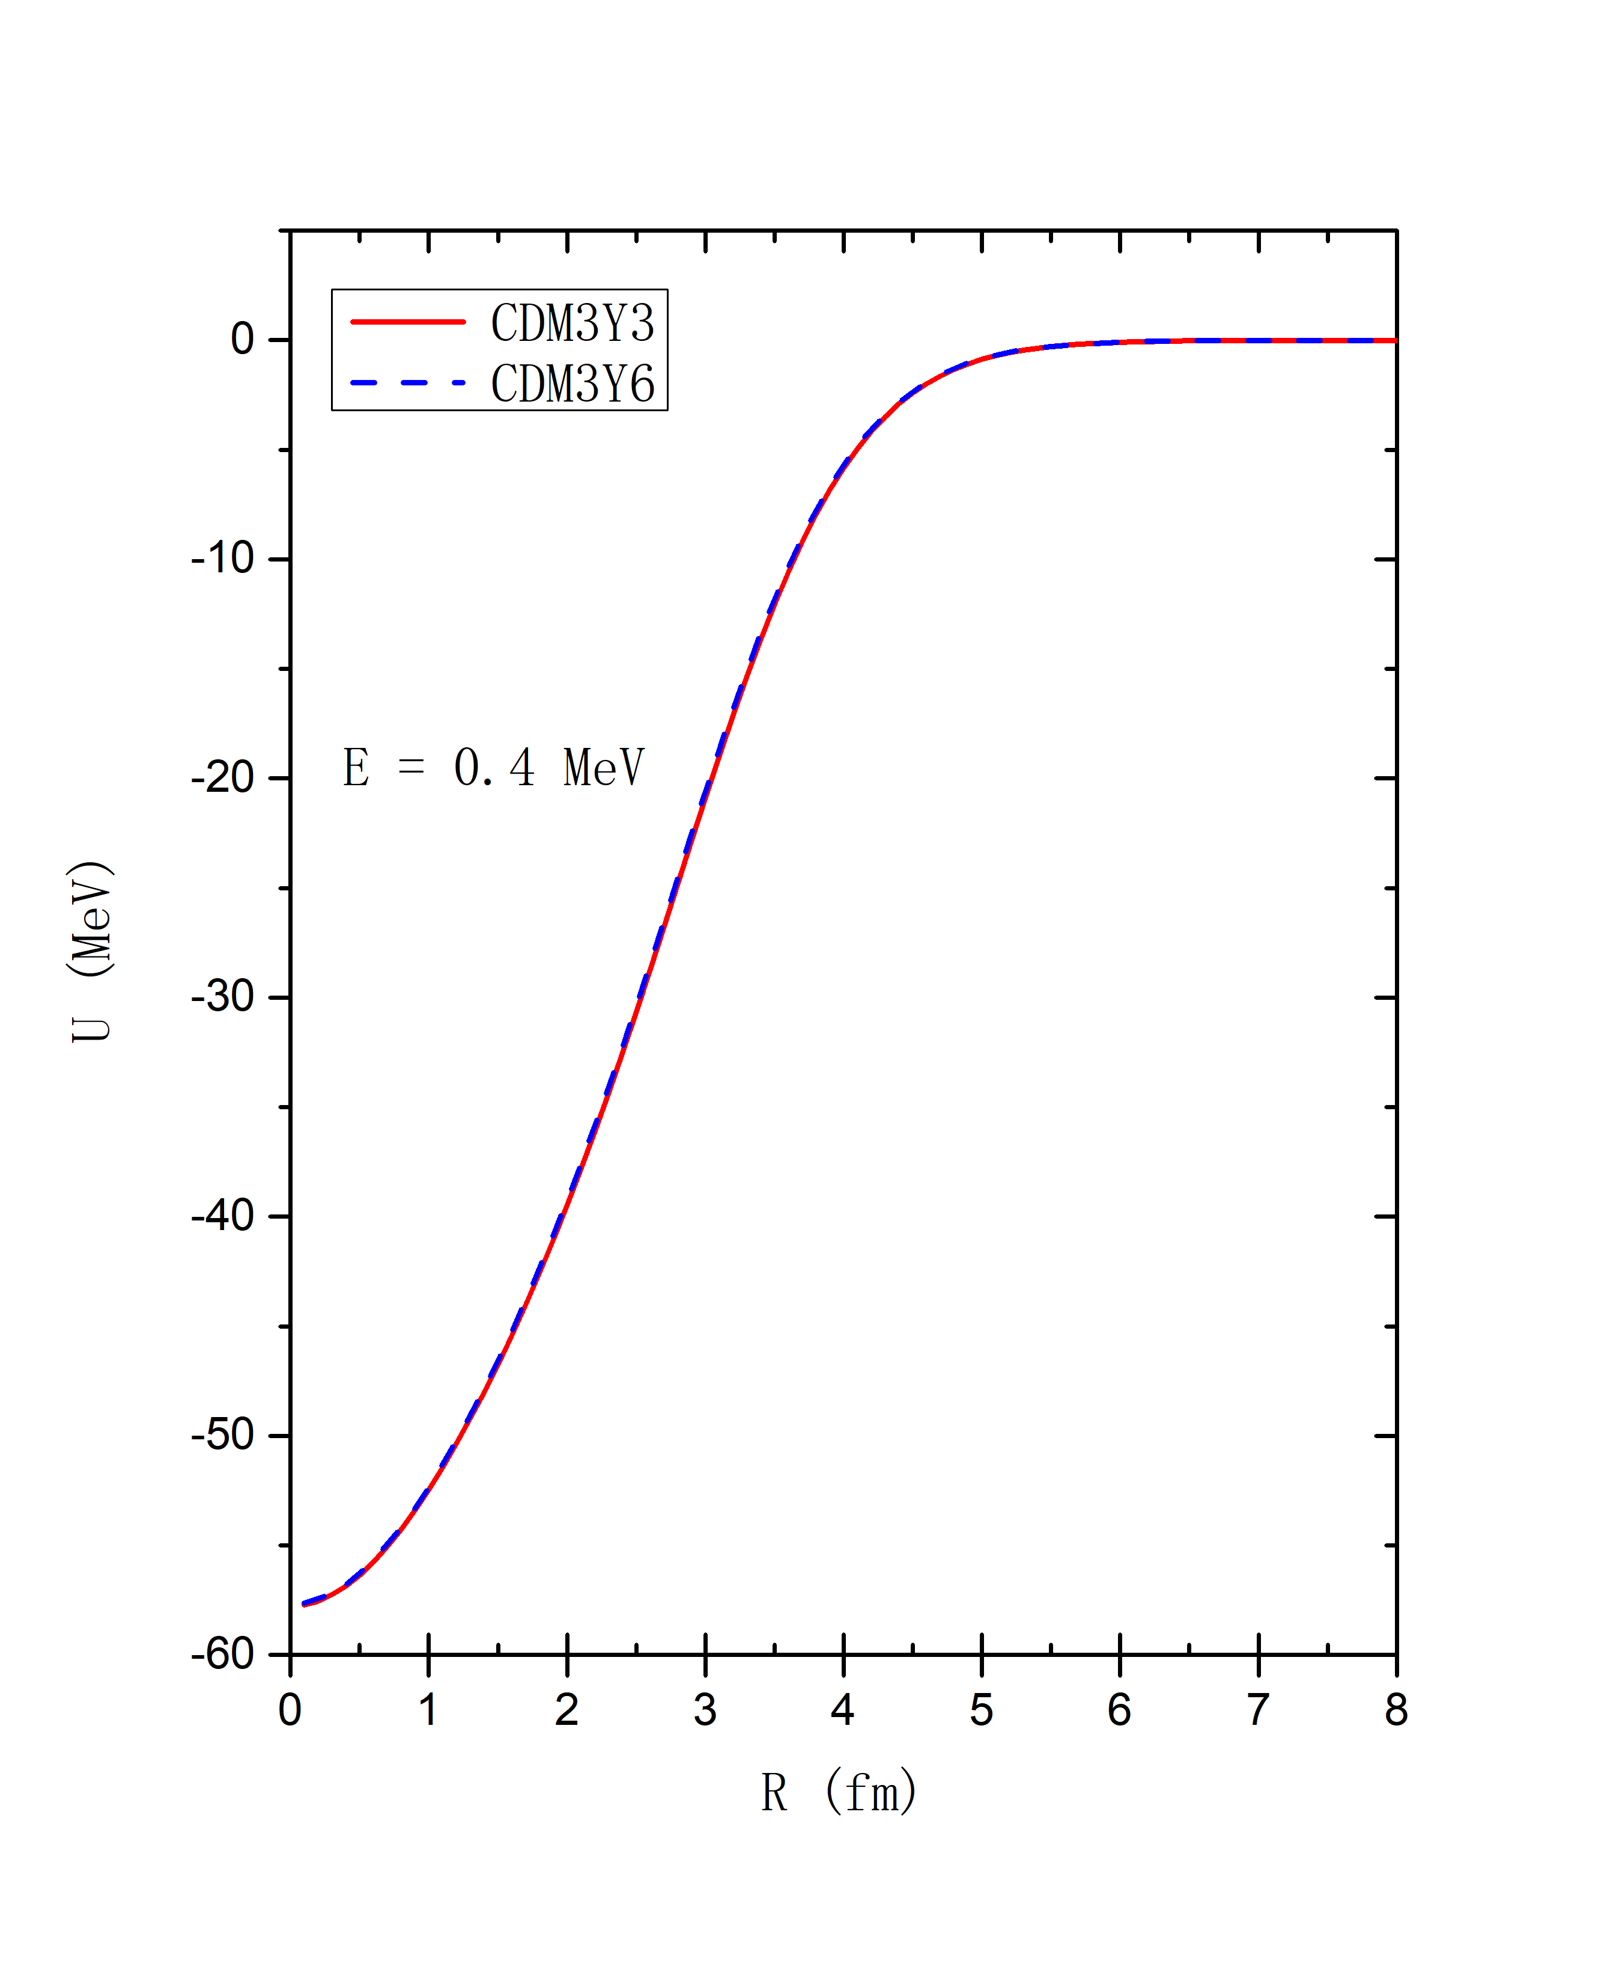
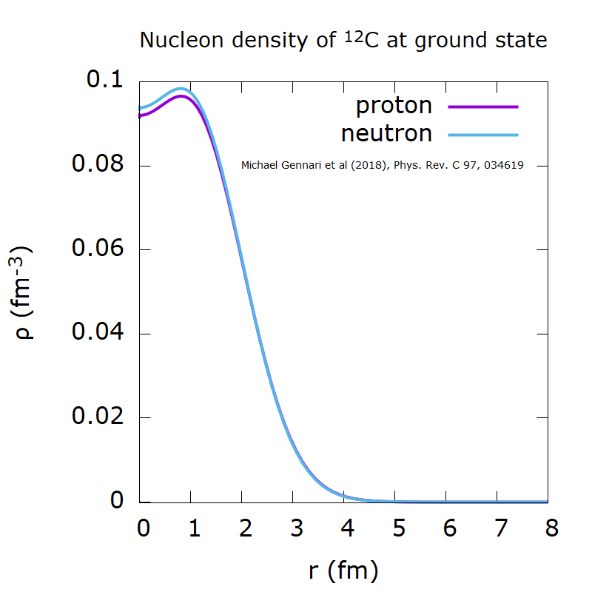
NUCLEAR MEAN-FIELD POTENTIAL
Single folding model
Folding model potential of p + 12C scattering
$$U=\sum_{j∈A}{\left\langle \vec{k},j\left|v_{c}^{D}\right|\vec{k},j\right\rangle +\left\langle \vec{k},j\left|v_{c}^{EX}\right|j,\vec{k}\right\rangle }$$
$$U\left(\vec{R}\right)=\int{drρ_{A}\left(\vec{r}\right)v_{NN}\left(\vec{r}−\vec{R},ρ\right)}$$
effective NN interaction v_{NN}
r
R
mean-field
8

Slide 9
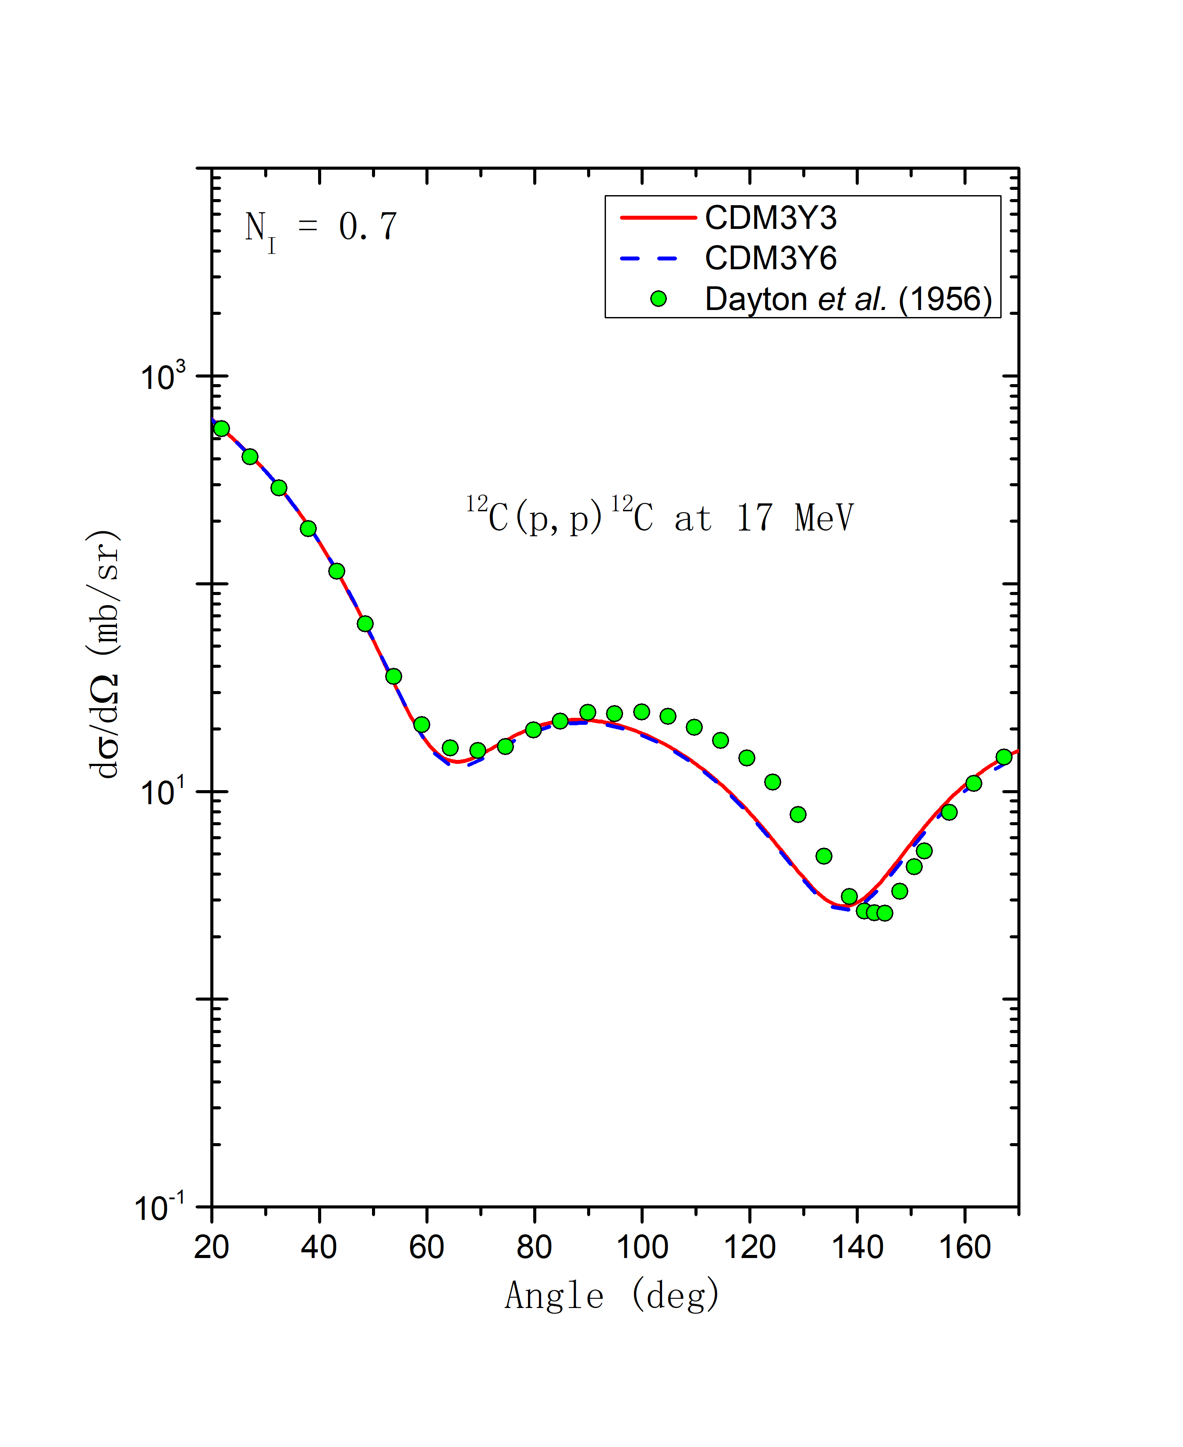
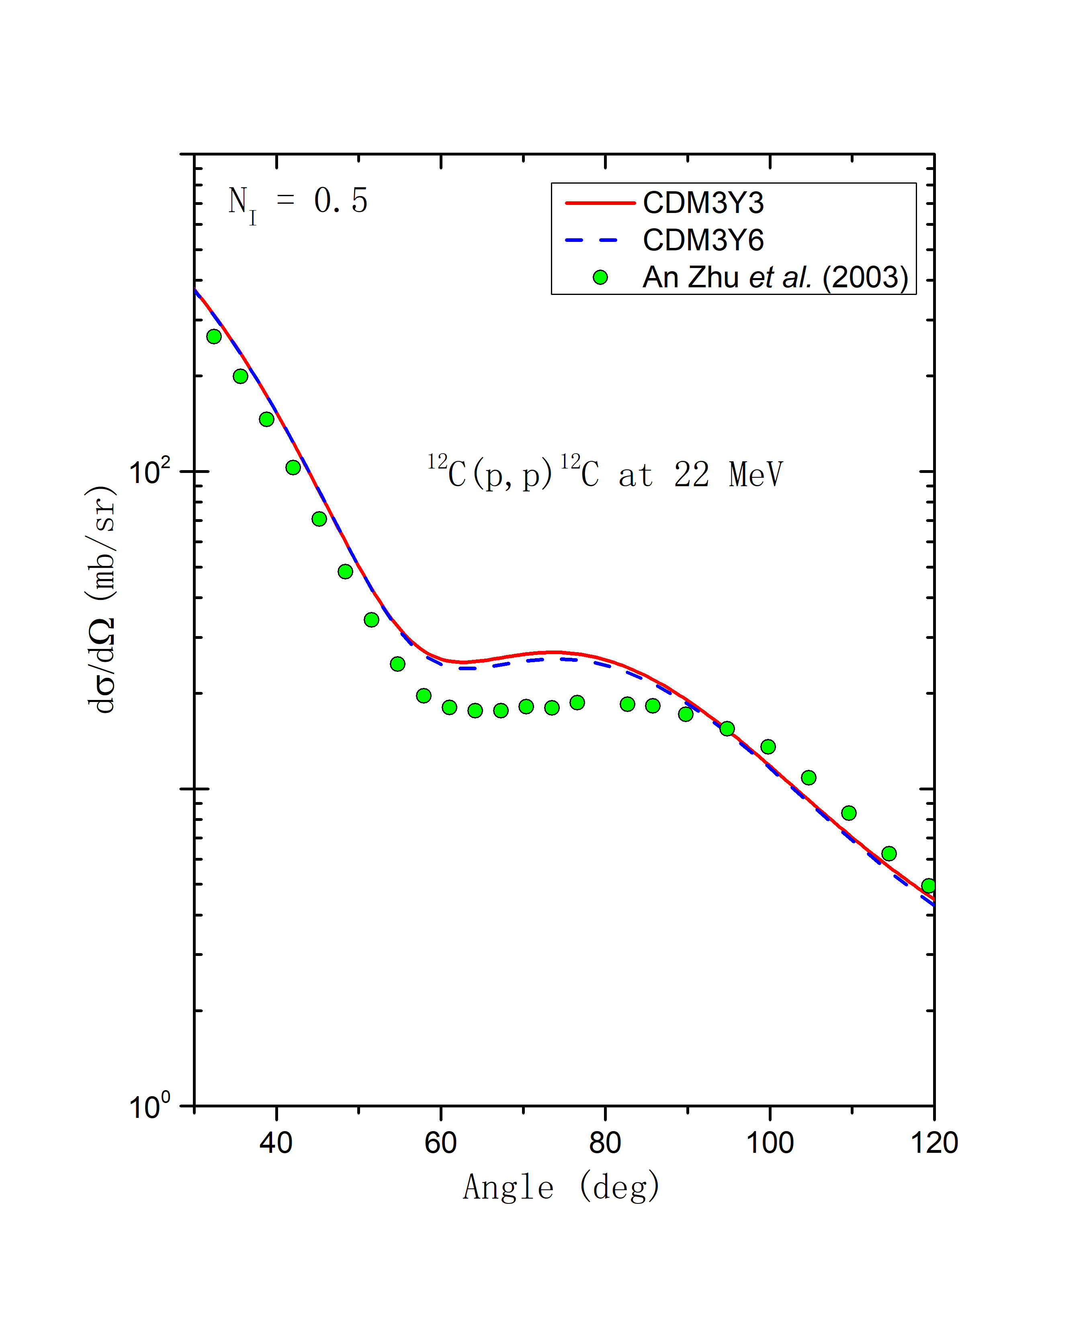
NUCLEAR MEAN-FIELD POTENTIAL
Elastic (p + ¹²C) scattering
9

Slide 10
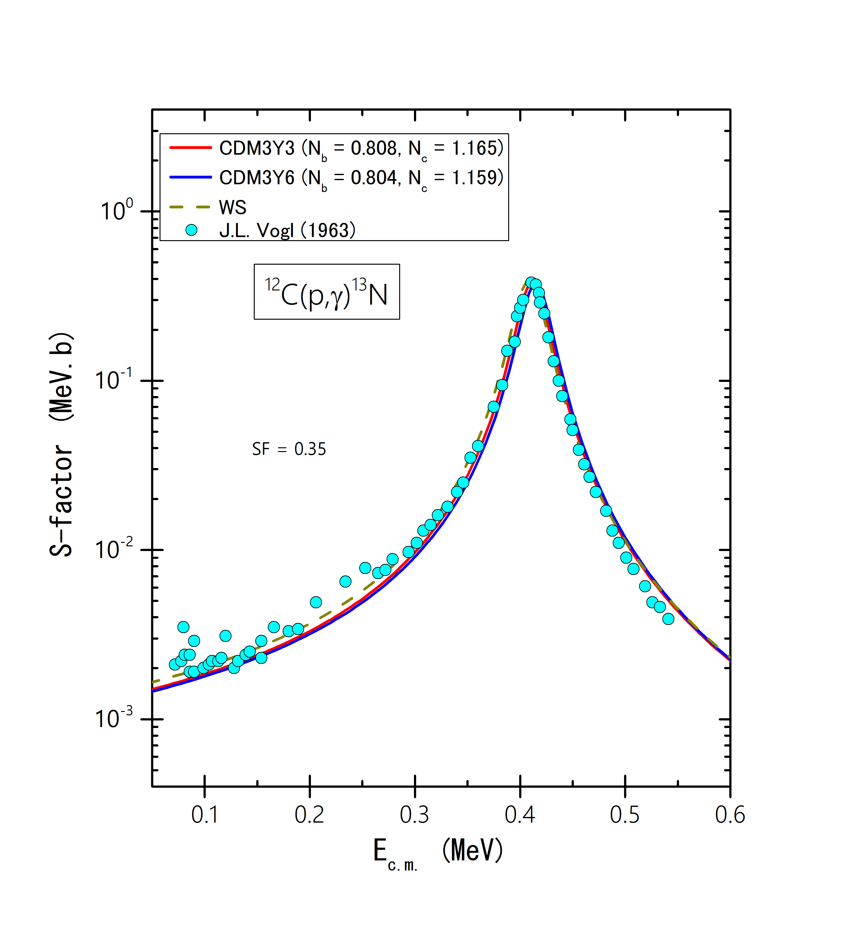
MEAN-FIELD DESCRIPTION OF
THE ¹²C(p,γ)¹³N AND ¹³C(p,γ)¹⁴N REACTIONS
¹²C(p,γ)¹³N
2.36 MeV (1/2⁺)
E_{x} = 0.42 MeV
p + ¹²C
Q = 1.94 MeV
E_{γ}
G.S. (1/2⁻)
¹³N
S-factor
$$S\left(E\right)=E\exp\left(2πη\right)σ\left(E\right)$$
10
Notes:
In stellar evolution, the 12C(p, γ)13N reaction plays a key role for the following reasons. Firstly, it is the first reaction in the Carbon-Nitrogen-Oxygen (CNO) cycle which dominates the energy production in stars with masses heavier than 1.5 M [1,2]. Secondly, the 12C(p, γ)13N(β+)13C reactions can enhance the 13C abundance [3], and thus influence the 12C/13C ratio which is thought to be an important measure for stellar evolution and nucleosynthesis [4]. Thirdly, the supply of 13C by the 12C(p, γ)13N(β+)13C reactions is also important for the 13C(α, n)16O neutron source in the asymptotic giant branch (AGB) stars. A recent calculation with parametric one-zone nucleosynthesis showed that more 13C supply is needed at the end of the CNO cycle in solar-metallicity stars [5]. In view of the above-mentioned significance, it is highly desirable to carefully investigate the 12C(p, γ)13N cross section at energies below 1.0 MeV for the astrophysical interest
10

Slide 11
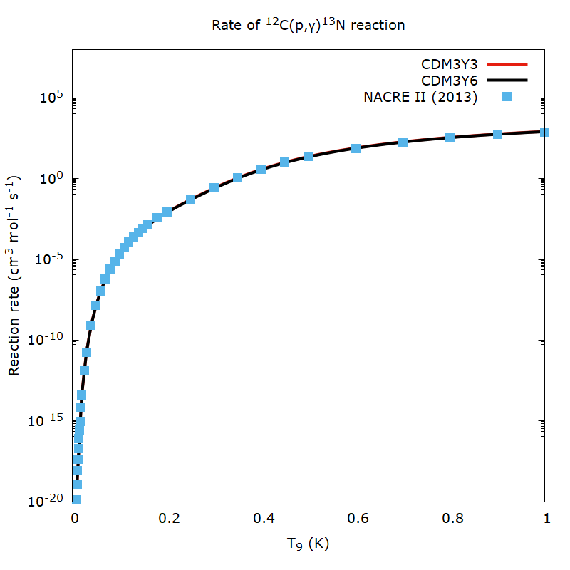
MEAN-FIELD DESCRIPTION OF
THE ¹²C(p,γ)¹³N AND ¹³C(p,γ)¹⁴N REACTIONS
¹²C(p,γ)¹³N
Reaction rate
$$\left\langle σv\right\rangle ={\left(\frac{8}{πμ}\right)}^{\frac{1}{2}}\frac{1}{{\left(k_{B}T\right)}^{\frac{3}{2}}}\int_{0}^{∞}{σ\left(E\right)E\exp\left(−\frac{E}{k_{B}T}\right)dE}$$
11
Notes:
For low energy proton induced reactions, the cross section times velocity, i.e., the reaction rate term, is approximately a constant
11

Slide 12
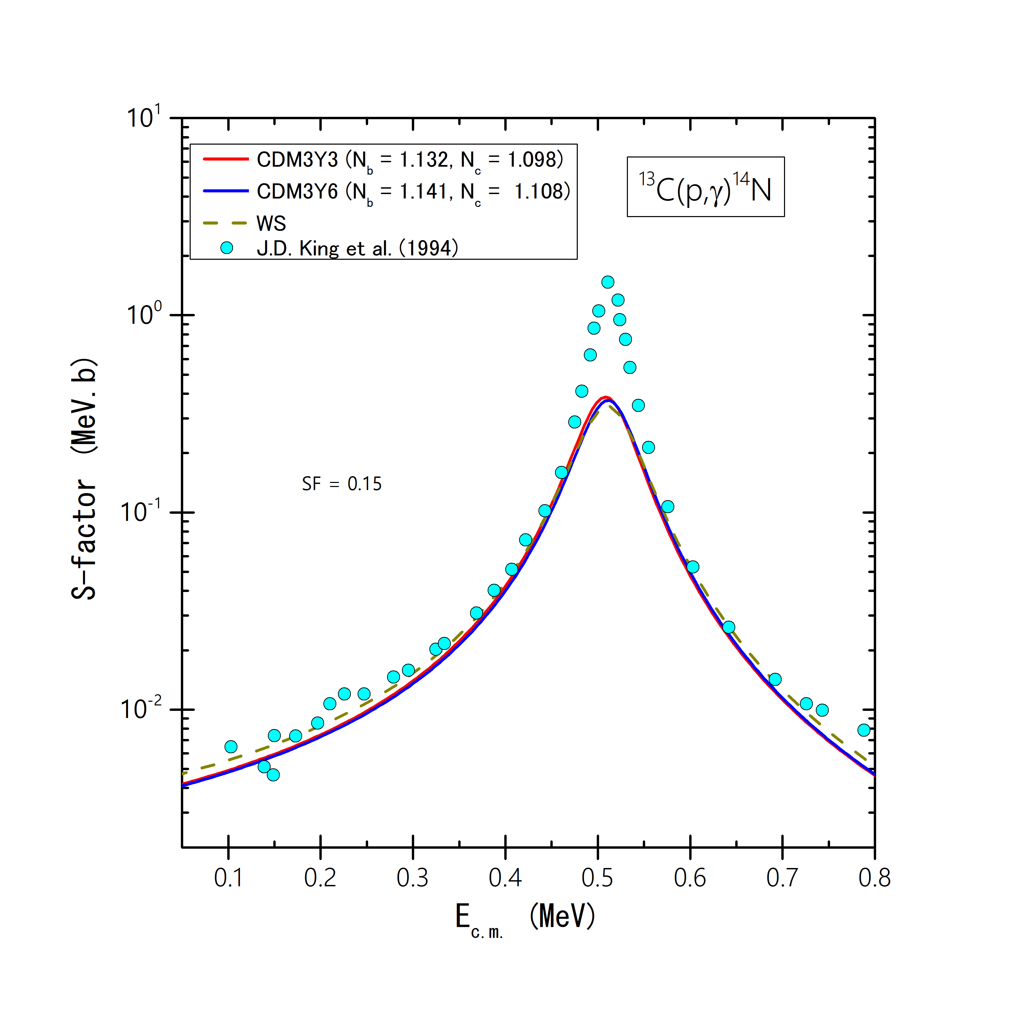
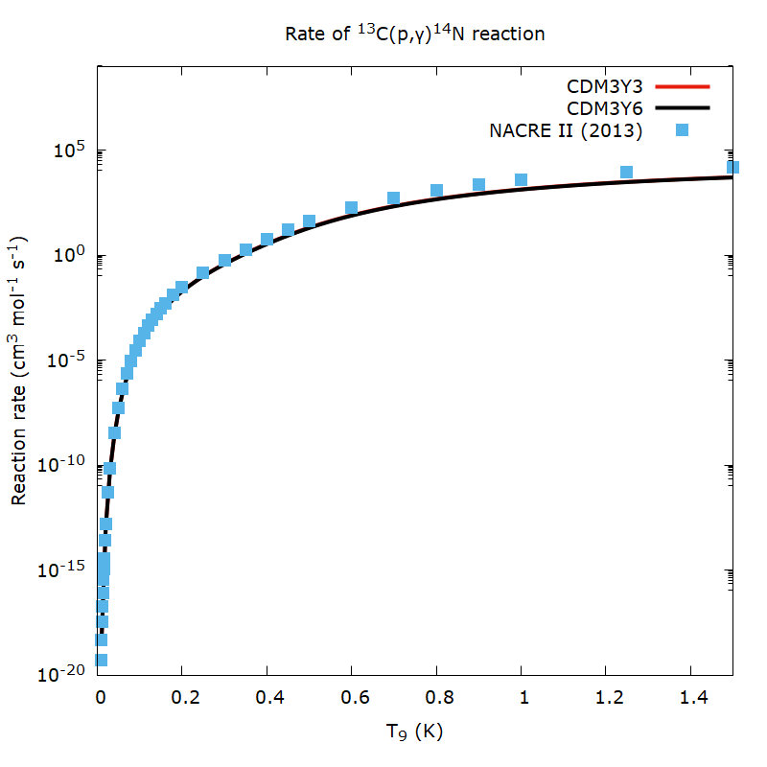
MEAN-FIELD DESCRIPTION OF
THE ¹²C(p,γ)¹³N AND ¹³C(p,γ)¹⁴N REACTIONS
¹³C(p,γ)¹⁴N
12
J. T. Huang et al. Atom.Data Nucl.Data Tabl. 96 (2010)

Slide 13
SUMMARY
The folded potential gives a good OM description of the elastic p+¹²C scattering at several energies.
This SFM approach is further used to calculate the nuclear mean-field potential for the study of the astrophysical S factor of the ¹²C(p,γ)¹³N and ¹³C(p,γ)¹⁴N reactions.
Reaction rates of the radiative capture reactions which are an importantly astrophysical quantity are produced to describe effectively the experimental data.
13

Slide 14
THANK YOU FOR YOUR ATTENTION!
14

