Slide 1
CNS Summer school 2023
Investigation of ⁶He halo structure and neutron correlations at CRIB via elastic and transfer reaction: p+⁶He
Qian Zhang
2023. 08. 07
Yamaguchi Lab | CNS, The University of Tokyo zhangq22@cns.s.u-tokyo.ac.jp
-1-

Slide 2
Acknowledgments
Collaborators
Q. Zhang^{a,b}, M. Sferrazza^{c}, H. Yamaguchiª, S. Hayakawaª, K. Okawaª, P. Descouvemont^{c}, M. La Cognata^{d}, G. Pizzone^{d}, A. Dipietro^{d}, S. Cherubini^{d}, N. Tian^{e}, Y. Y. Li^{e}, K. Sakanashi^{f}, Y. Honda^{f}, S. Etelaeniemi^{f}, N. Imaiª, N. Kitamuraª, J. Hwang^{h}, D. S. Ahn^{h}, C. Soomi^{h}, G. Gu^{h}, S. Kim^{h}, C. Kim^{h}, T. Chilleryª, J. T. Liª, J. Hu^{e}, K. Yakoª, S. Hanaiª, F. L. Liu^{a,i}, S. Masuokaª
ª Center for Nuclear Study, the University of Tokyo
^{b} Lanzhou University
^{c} Université Libre de Bruxelles
^{d} Istituto Nazionale di Fisica Nucleare, Laboratori Nazionali del Sud
^{e} Institute of Modern Physics, Chinese Academy of Sciences
^{f} Osaka University
^{g} Institute for Basic Science
^{h} Sungkyunkwan University
^{i} China institute of atomic energy
Supporter: CHINA SCHOLARSHIP COUNCIL
-2-

Slide 3
Content
Introduction
Experimental setup
Experimental results
Conclusions
PPT模板下载：www.1ppt.com/moban/ 行业PPT模板：www.1ppt.com/hangye/
节日PPT模板：www.1ppt.com/jieri/ PPT素材下载：www.1ppt.com/sucai/
PPT背景图片：www.1ppt.com/beijing/ PPT图表下载：www.1ppt.com/tubiao/
优秀PPT下载：www.1ppt.com/xiazai/ PPT教程： www.1ppt.com/powerpoint/
Word教程： www.1ppt.com/word/ Excel教程：www.1ppt.com/excel/
资料下载：www.1ppt.com/ziliao/ PPT课件下载：www.1ppt.com/kejian/
范文下载：www.1ppt.com/fanwen/ 试卷下载：www.1ppt.com/shiti/
教案下载：www.1ppt.com/jiaoan/ PPT论坛：www.1ppt.cn
-3-

Slide 4
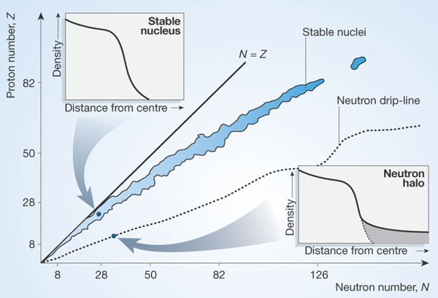
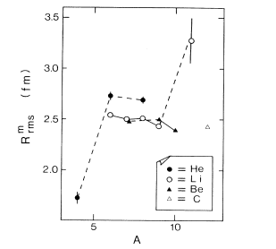
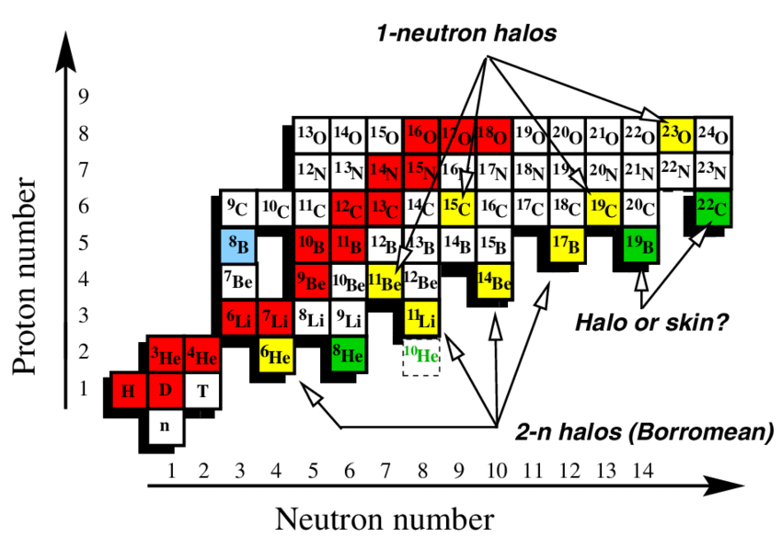
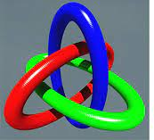
Introduction
Tanihata-1985
A=11
6-8 MeV
A=6
A=8
<1 MeV, ⁶He: 0.973 MeV, ¹¹Li: 0.3 MeV
B. Jonson, Phys. Rep. 389 (2004)
D. Hinder et al., 2004 Nature 431, 749 (2004)
Differences in radii were seen for isobars with A= 6, 8, 9.
Neutrons tunnel far from the core and form a halo.
Borromean nuclei
+ n or n + n unbound
⁴He
+ n + n bound as ⁶He
https://iopscience.iop.org/book/mono/978-1-6817-4581-7/chapter/bk978-1-6817-4581-7ch2.
⁴He
-4-

Slide 5
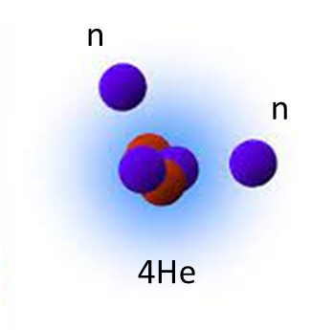
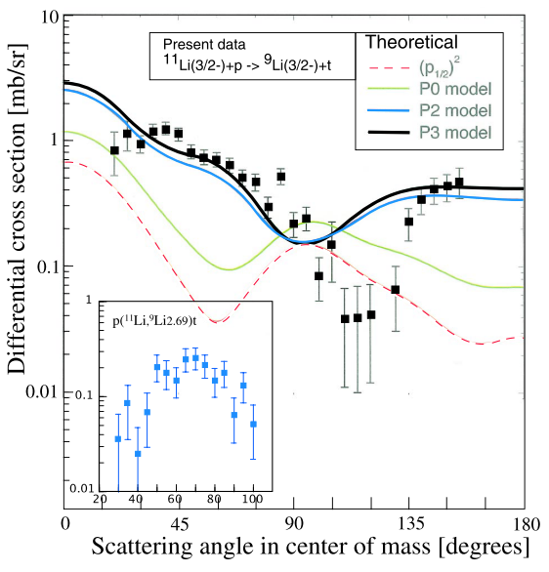
Introduction
¹¹Li(p,t)⁹Li reaction at E= 3.3 MeV/u
The lightest halo nuclei: ⁶He
0.97MeV
So what is the correlation between two neutrons of ⁶He nucleus ?
The fitting to the angular shape is less satisfactory? Reasons: Complex structure and optical potentials.
Cigar configure or dineutron configure ?
⁶He is a good candidate to study the reaction mechanisms with light target.
I. Tanihata et al., PRL 100, 192502 (2008)
-5-

Slide 6
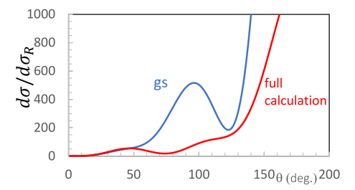
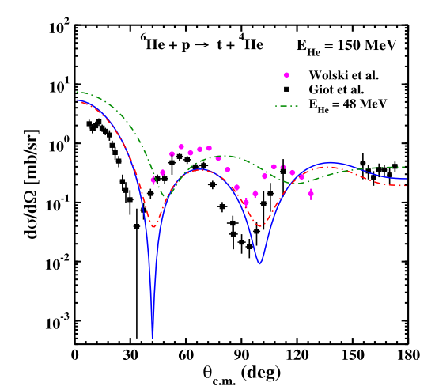
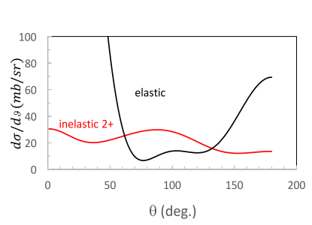
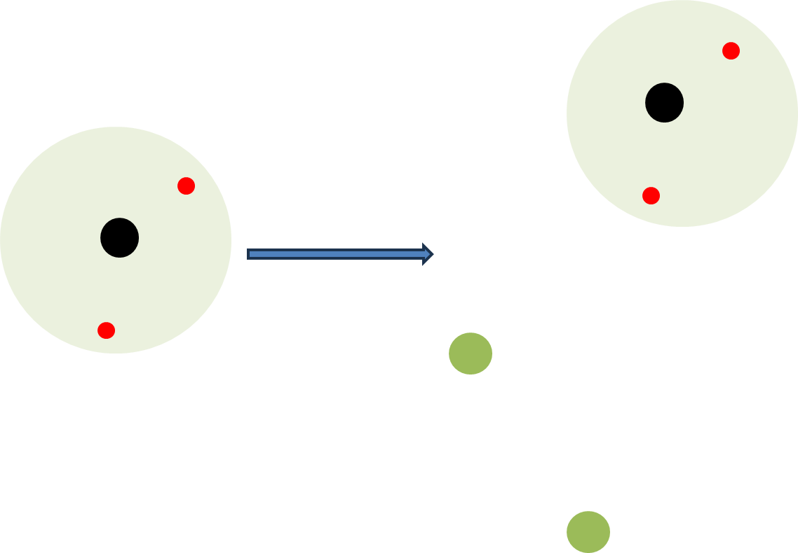
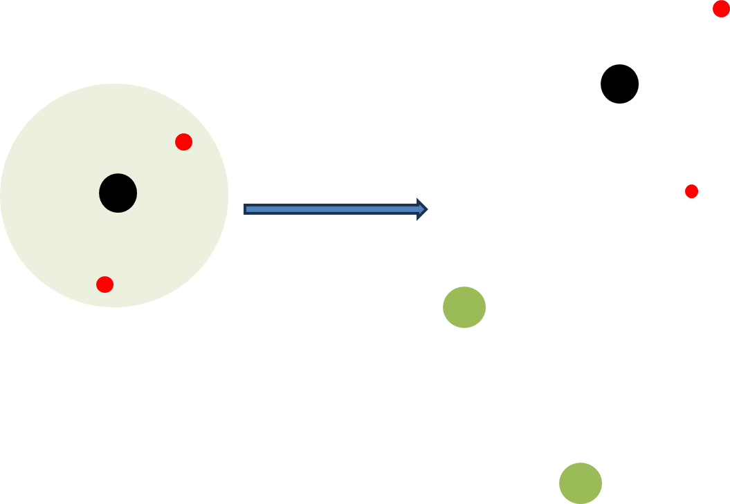
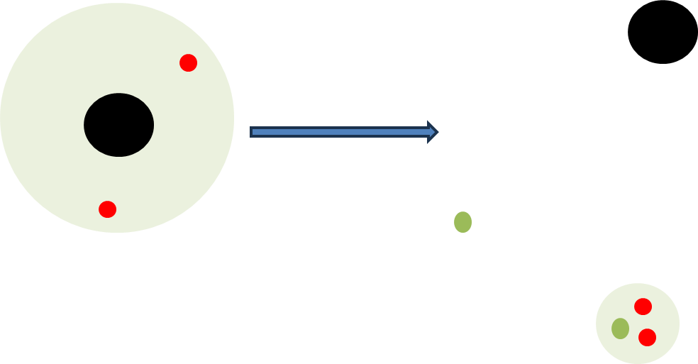
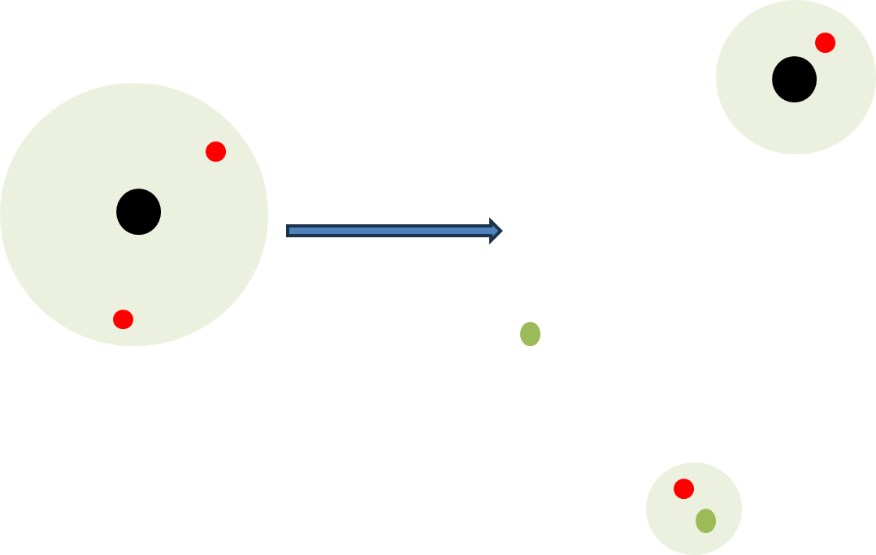
Introduction
Elastic
Break up
⁶He+p elastic cross section at E_{c.m.=}10 MeV in two different conditions of calculation (with only the gs and with the 2+ continuum state).
Transfer
halo structure and neutron correlation
M. Sferrazza and H. Yamaguchi, NP-PAC-21, NP2012-AVF70 (2020)
-6-

Slide 7
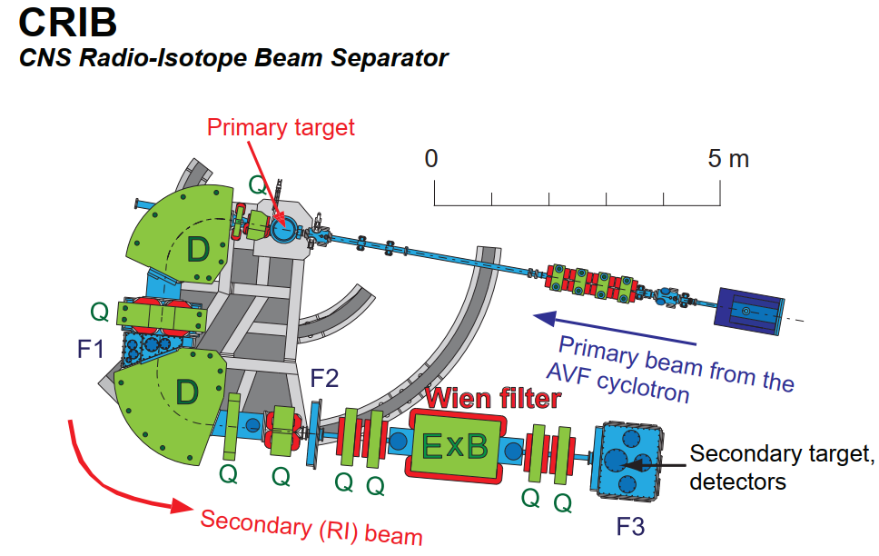
Experimental setup
Cryogenic D₂ target, ~730 Torr, 90 K,
⁷Li(d,³He)⁶He
Degrader
20 μm Mylar foil
Primary beam:
⁷Li³⁺, 6 eμA, 8.3 MeV/u
CH₂: 50 μm
Carbon: 25 μm
⁶He(p,p₀/p₁)6He
⁶He(p,t)⁴He
⁶He(p,d)⁵He
⁶He Energy at target
7.5 MeV/u
At F2, ⁶He²⁺~87%, ³H⁺~13%
Energy: 7.9 MeV/u
-7-

Slide 8
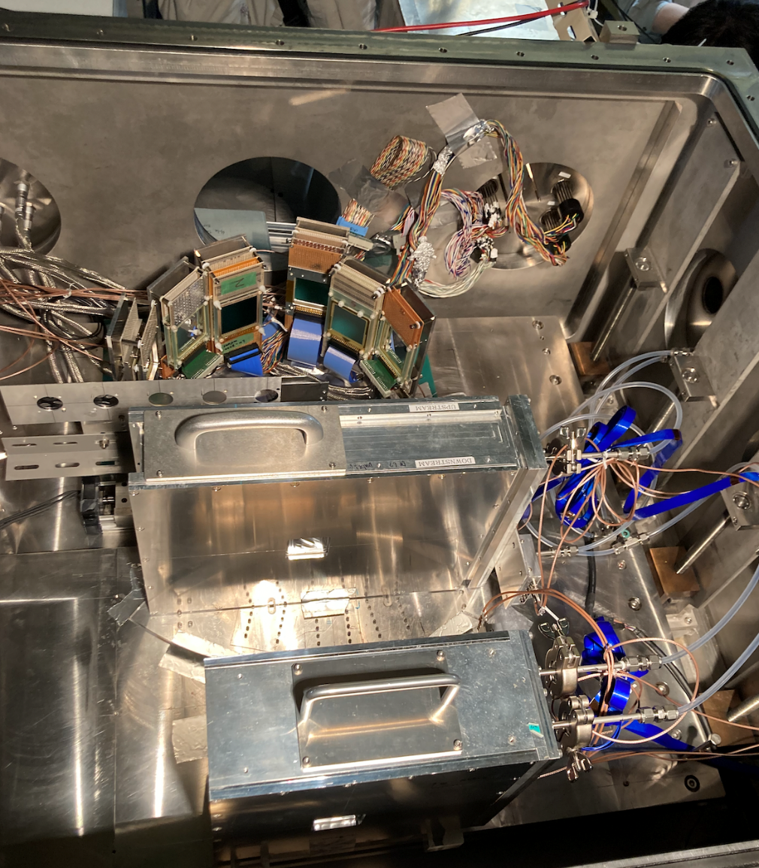
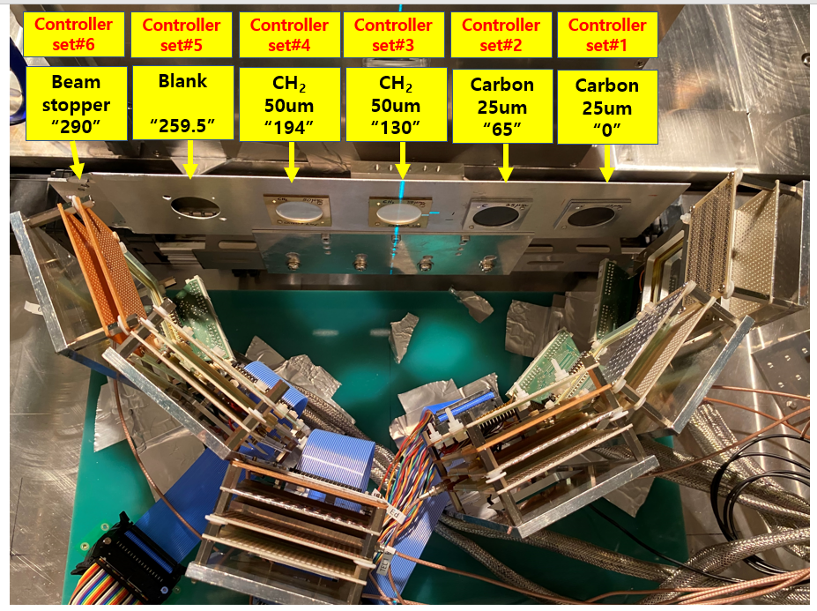
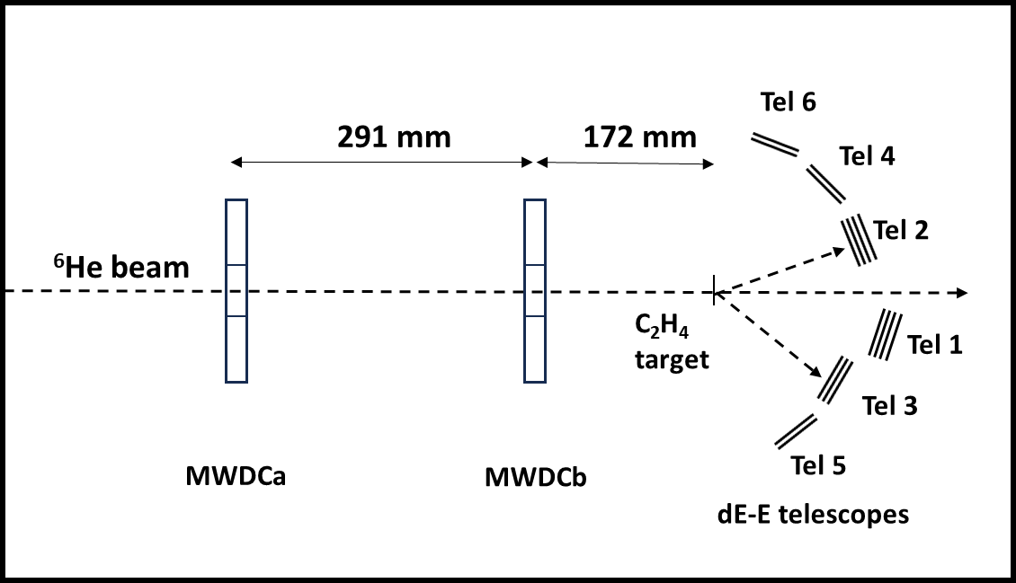
Experimental setup
Detector configuration in F3 chamber
Beam
-8-

Slide 9
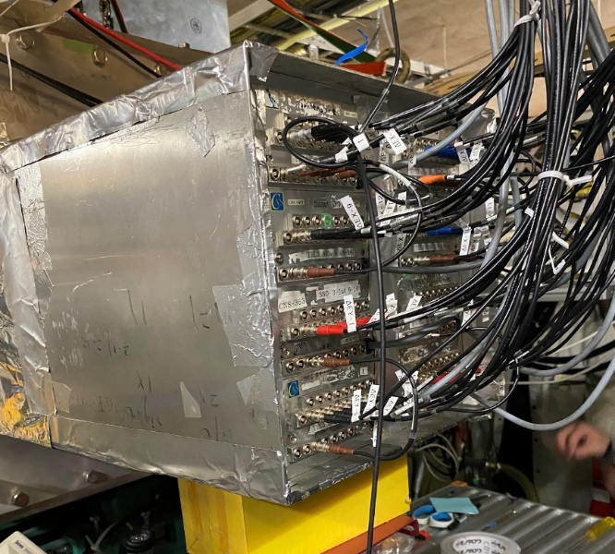
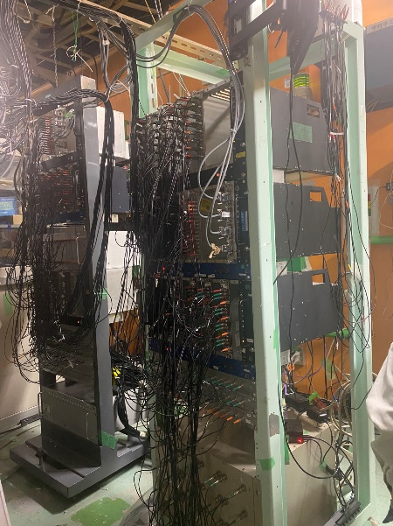
Experimental setup
Traditional circuits + Multiplexer circuits
Traditional circuit
Multiplexer circuits
Double side silicon detector (DSSD)
tel1: MPR-16 + MSCF
tel2-3: GSI PA + MA/(FA+CFD)
tel4-6: MUX-32 + HPF
Single side silicon detector (SSD)
ClearPulse PA + HPF + STM-16
-9-

Slide 10
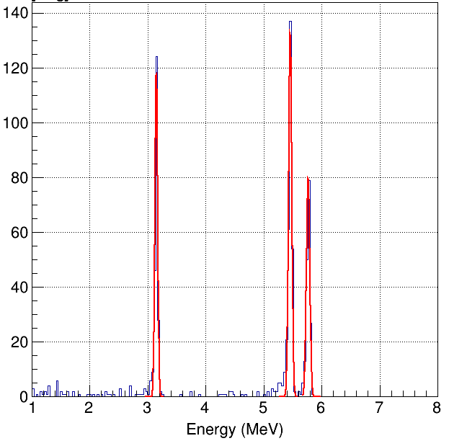
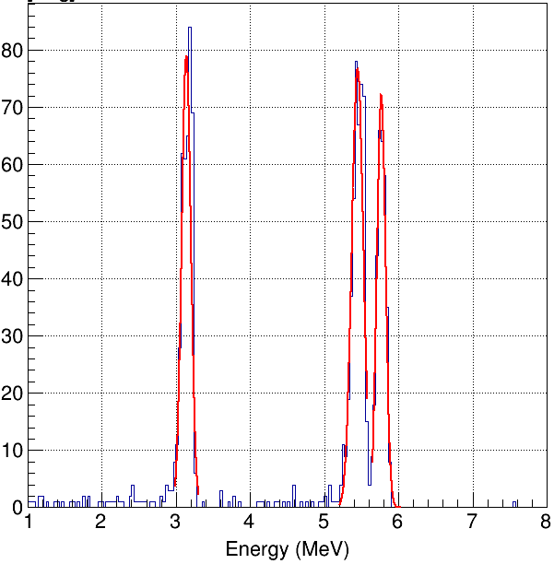
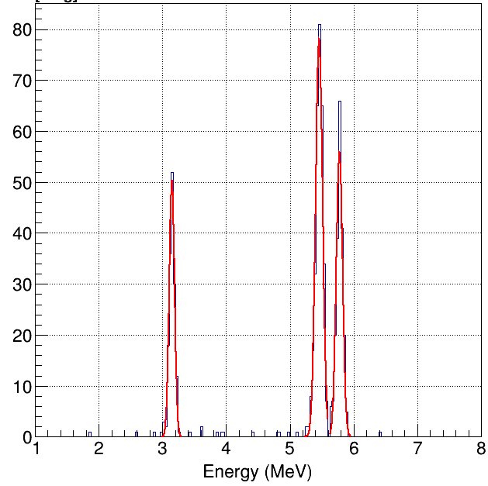
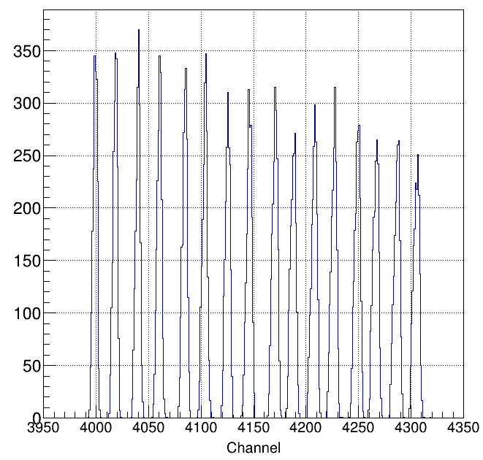
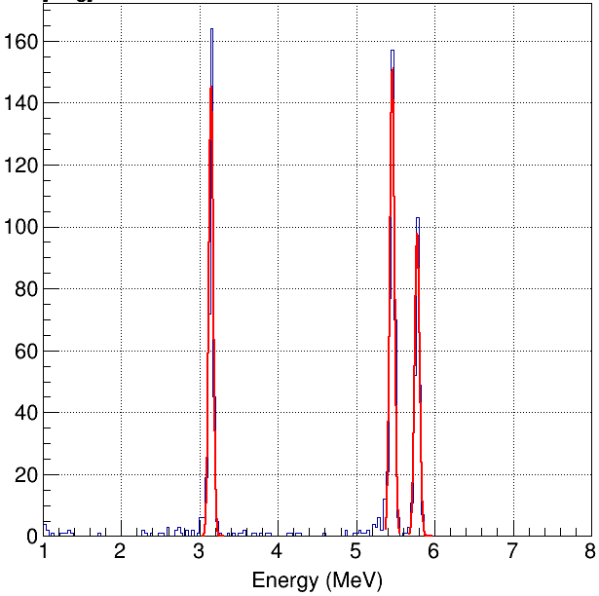
Experimental setup
MPR+MSCF (tel1 DSSD)
Original circuit (tel2 DSSD)
tel1 SSSD
5.458
300 μm
3.148 MeV
Resolution 1.8%
300 μm
3.139 MeV
Resolution 4.6%
75 μm
3.147 MeV
Resolution 3.1%
5.767
MUX + HPF (tel4 DSSD)
Strip 1
73 μm
3.147 MeV
Resolution 2.1%
The energy resolution is less than 5%, and we can get a good position information of MUX.
Strip 1
-10-

Slide 11
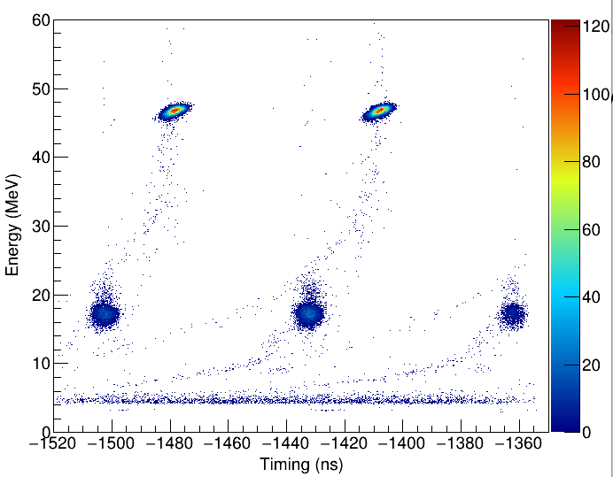
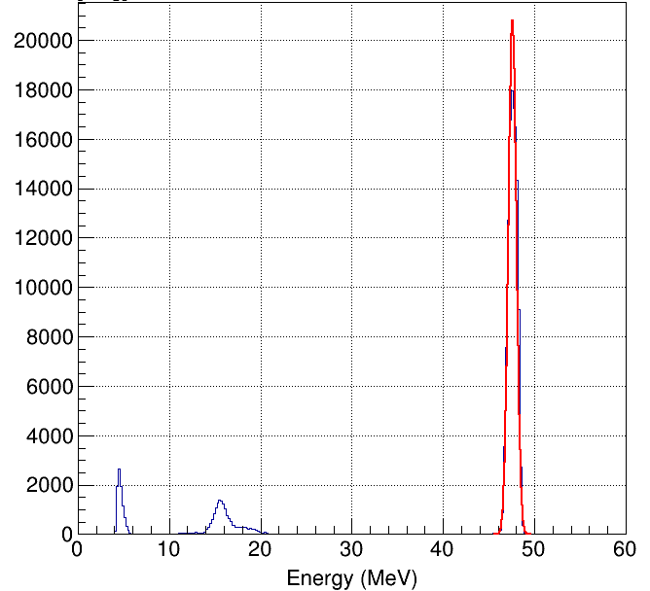
Experimental result
Particle identification at the F2 focal plane
⁶He
Energy 47.6 MeV
FWHM ~1.0 MeV
³H
Purity : ⁶He/(⁶He+³H) ~ 87.3%
-11-

Slide 12
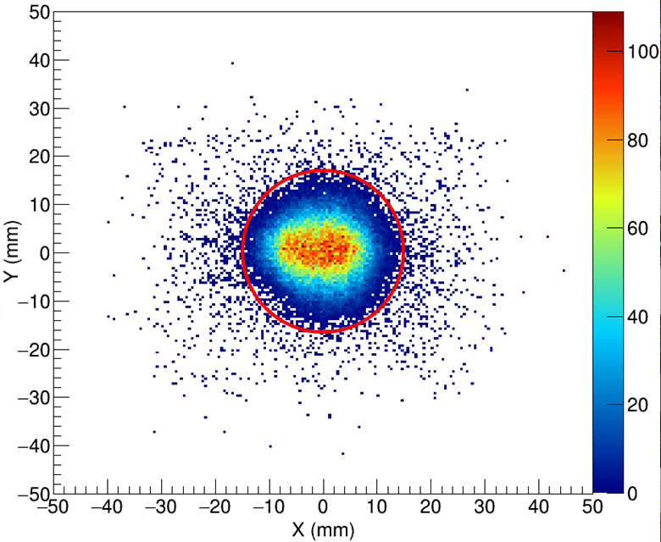
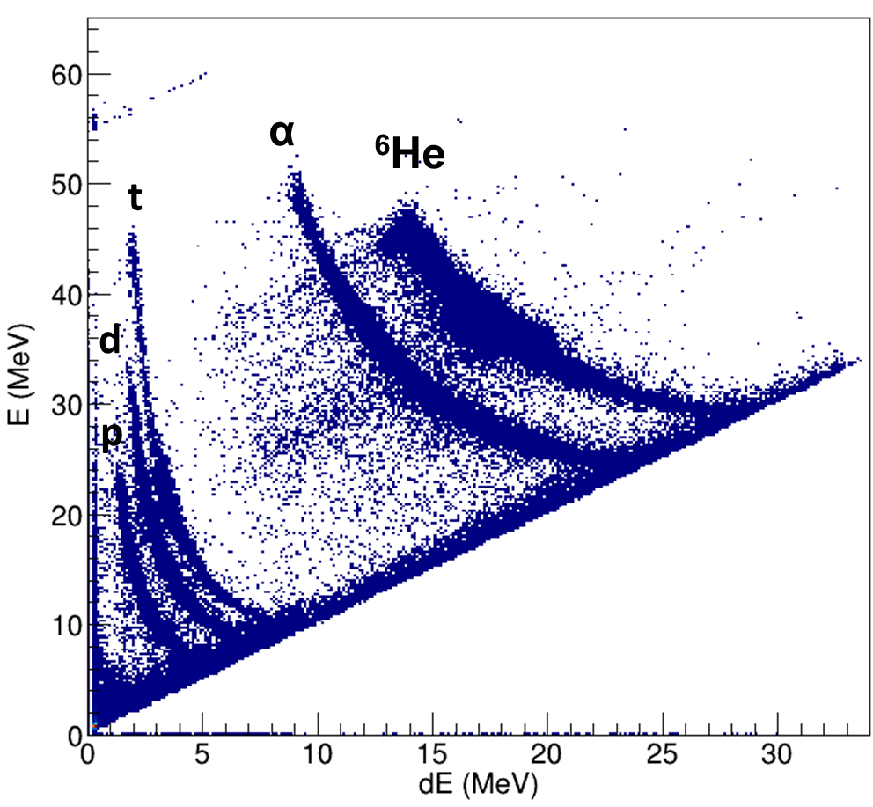
Experimental result
Beam profile in target
Telescope 1
The beam limited in red area (radius <15 mm) account for 97% of the all the beam events.
The p, d, t, α, ⁶He are identified with the E-dE method.
-12-

Slide 13
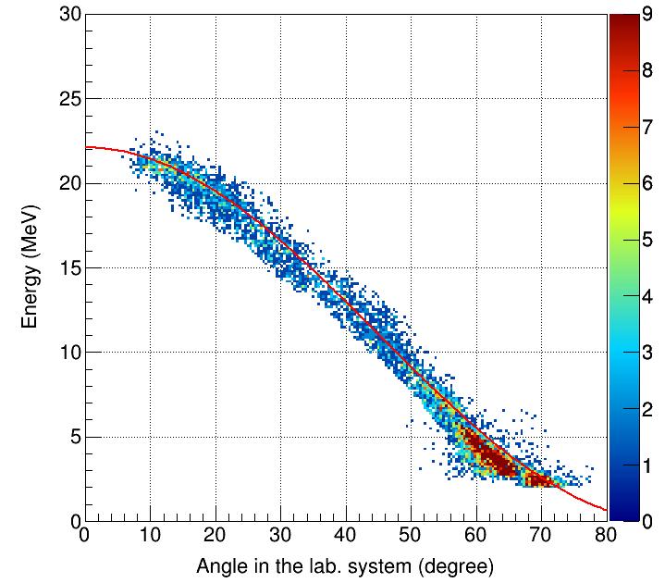
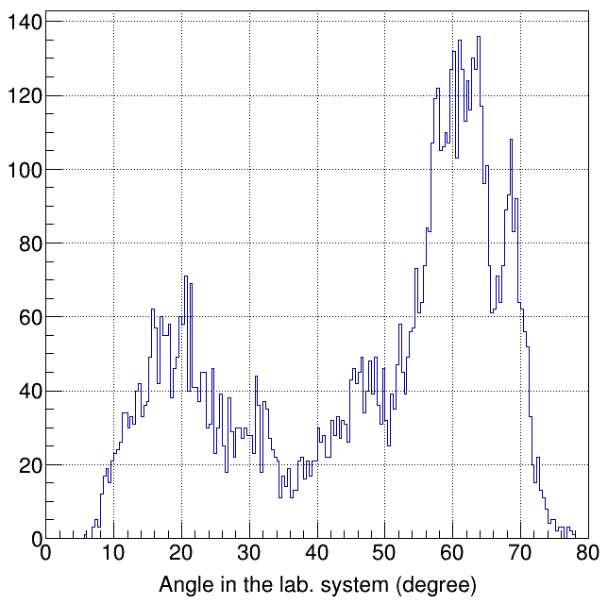
Experimental result
Elastic scattering: p + ⁶He for tel1-tel6
Kinematical curve
Accumulated time was ~1 hour
Projection to
x axis
We obtained the proton elastic event in the angle range from 10-70 degrees, corresponding to 160-40 degrees in the c.m. system.
-13-

Slide 14
Conclusions
⁶He+p reaction is a good candidate to study halo structure and neutron correlation.
The ⁶He+p experiment was performed at CRIB, and p, d, t, α, ⁶He particles were identified by E-dE method.
We obtained the elastic scattering data in the angle range from 10 to 70 degrees.
The analysis is ongoing.
Thanks for your attention！
Yamaguchi Lab | CNS, The University of Tokyo zhangq22@cns.s.u-tokyo.ac.jp
-14-

