Slide 1
Gamma-ray measurement for isomeric decays in proton-rich pf-shell nuclei at SHARAQ spectrometer
Yuki Nakamura for SHARAQ collaboration
Tokyo City University

Slide 2
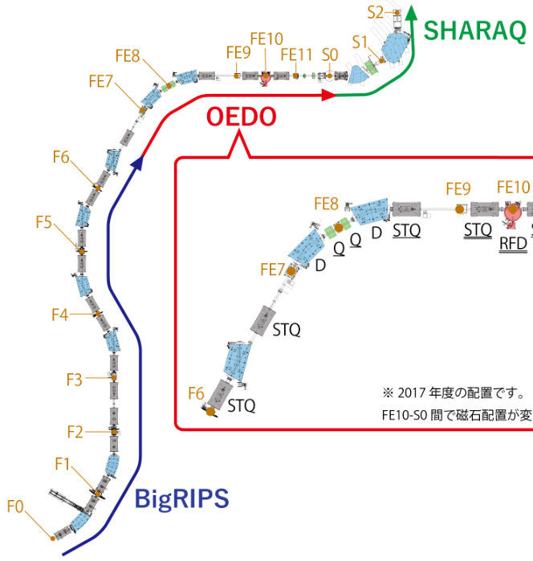
Introduction
The mass measurements of proton-rich unstable
nuclei towards two proton emitters have been
performed utilizing the TOF-Bρ method with
BigRIPS and OEDO-SHARAQ at RIBF.
Our original purposes are discoveries of new isomers
in this region.
In this presentation, γ-ray energies and lifetimes
of known isomers are compared with reference
values.
Fig.1：Beam line in RI Beam Factory

Slide 3
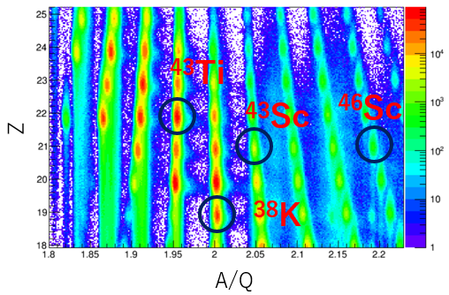
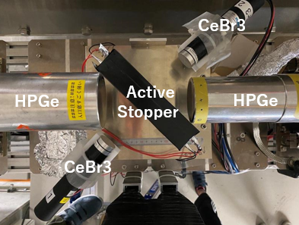
Experiment
We utilized this system to investigate
and assess the known isomers, namely,
³⁸K, ⁴³Sc, ⁴⁶Sc, and ⁴³Ti.
Fig.3：Particle Identification Diagram
Fig.2：Setup of delayed γ-ray spectroscopy

Slide 4
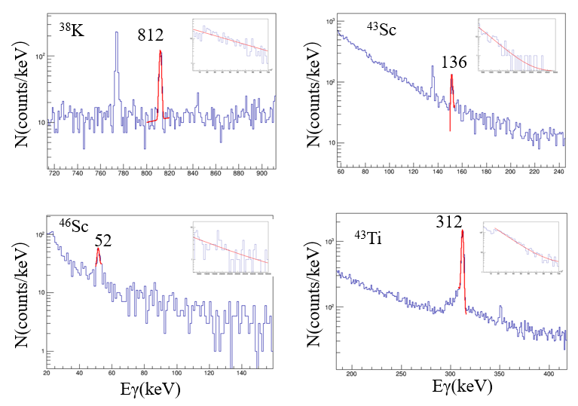
Experimental results
The peaks of delayed Gamma rays were identified at 812 keV for ^{38m}K,
136 keV, 151 keV, 1157 keV, and
1830keV for ^{43m}Sc, 52 keV for ^{46m}Sc,
and 312 keV for ^{43m}Ti.
Fig.4：our results of γ-ray energy and half life

Slide 5
Summary
From the measurement results, it was confirmed that the observed gamma-
ray peaks in this analysis originated from ³⁸K, ⁴³Sc, ⁴⁶Sc, and ⁴³Ti.
We verified the precise understanding of the characteristics of these isomers.
The system exhibited high performance, clearly demonstrating its efficacy as
a valuable tool for isomer measurements.
As a future outlook, we aim to utilize this isomer tagging system to explore
unknown isomers and conduct precise analyses to determine the values of
energy and half-life for isomeric states that have not been sufficiently
characterized.

