Slide 1
Nuclear data generation by machine learning
A3F-CNS Summer school 2023 Aug.8
Speaker: Shoto Watanabe¹
Colabolator:
Masaaki Kimura², Futoshi Minato³, Nobuyuki Iwamoto^{1,4}, Souta Yoshida⁵
¹Hokkaido-Uni., ²Riken., ³Kyushu-Univ. ⁴JAEA., ⁵Utsunomiya-Univ.
1

Slide 2
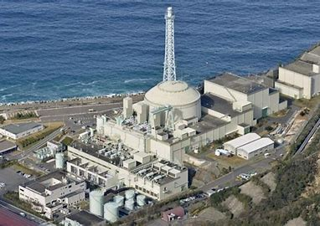
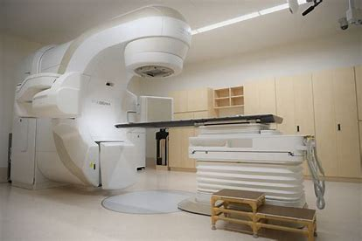
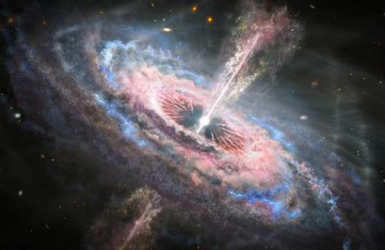
2
Nuclear data evaluation and machine learning
○ Nuclear data plays an important role in various scientific fields.
Exp.
nuclear reactor
radiation therapy
Cosmology simulation
Etc..
〇 In order to produce nuclear data for practical applications , it is essential to handle the huge amount of experimental data.
－ Evaluate the reliability and accuracy of experimental data, and make a selection.
－ Interpolation and extrapolation of experimental data using theoretical models
2
Notes:
First, I’ll speak about Nuclear data and machine learning
本文

Slide 3
Nuclear data evaluation and machine learning
◆ The Machine Learning (ML) for nuclear data science has been intensively studied.
Example
・Reproduction of fission yields using the mixture density network
^{nat}Ni(p,X)⁷Be
A. E. Lovell, A. T. Mohan and P. Talou, J. Phys. G, Vol. 47, 114001 (2020)
・Prediction of nuclear production cross-sections based on Gaussian process regression.
H. Iwamoto, J. Nucl. Sci. Technol. 57, 932 (2020)
▼ Some studies consider only experimental data
→ Improving the accuracy of estimation by using nuclear reaction models.
☆We report the results of prediction of elastic scatterings cross section at arbitrary
energies by combining nuclear reaction models and Gaussian process regression.
3
Notes:
Recently, the ML for nuclear data science has been intensively stuied. Many researchers have begun applying machine learning to nuclear data evaluation.
These are this example.
But, Some stude~~
So, We think adding nuclear reaction model, improve the accuracy of estimation. So we study this and make the system generating nuclear data at low cost combining machine learning and nuclear reaction model .
In this presentation, We report~~

Slide 4
Framework: Nuclear reaction model
◆ Coupled Channel Optical Model
$u_{c}:$ Wave function of scattered wave (radial direction)
$c$: Reaction channel ($\left\{l_{c}, j_{c}, n_{c}\right\}$)
$V_{cc^{′}}$: Optical potential(Between $c and c′$ channels)
We solve coupled channel equations using CCONE O. Iwamoto et al., Nucl. Data. Sheets 131, 259 (2016)
S. Kunieda et al, J. Nucl. Sci. Technol. 44, 838-852 (2007)
Estimate optimum value
4
Notes:
Ok, I speak Framework part. First, speak about Nuclear reaction model.
We use coupled channel optical model. To calculate this shrodinger equation, we get the cross section.
In this equation, V means optical potential. Optical potential consist of central force part, imaginary part, coulom force part, and Lsforce part.
In this presentation, focus on the energy dependence of the depth of central force part only. I call this is vr0 from here.

Slide 5
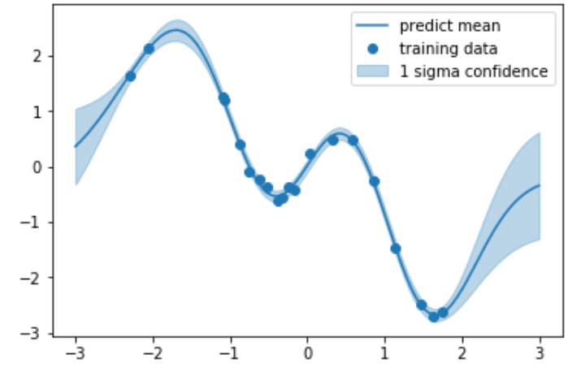
Framework : Machine Learning part
5
〇 Bayesian optimization with Gaussian process regression
－ A model that estimates a function from inputs and output variables, and find the minimum value of the objective function
〇Objective function describes the deviation between experimental data and theoretical calculation.
〇 Determine the potential parameters to minimize the Objective function .
:Parameter of optical potential
:Evaluation function
We use GPyOpt as Library of Gaussian process regression
https://sheffieldml.github.io/GPyOpt/
5
Notes:
Next, speak about Machine learning part.
We use Gaussian process reguression for prediction, and Bayesian optimization for collect traning data.
Gaussian process reguression is ~~~

Slide 6
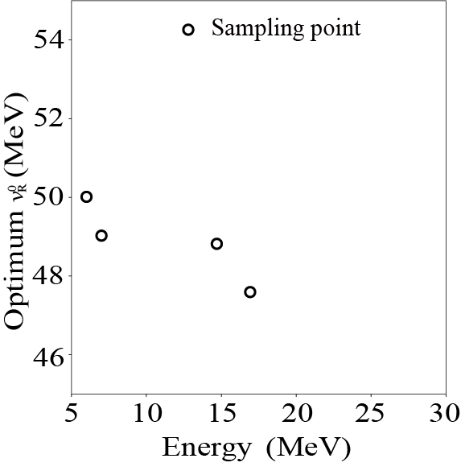
Framework: Research Procedure
☆ Predict the energy dependence of $v_{R}^{0}(E)$ by the following process.
1, Collect the $v_{R}^{0}\left(E\right)$ list
2, Predict the $v_{R}^{0}\left(E\right)$ using ML
Input : Energy (MeV) | Output: $v_{R}^{0}$ (MeV)
6 | 50.0
7 | 49.0
15 | 48.8
17 | 47.6
⇒
6
Notes:
I’ll show the results of prediction of elastic scatterings cross section at arbitrary energies, this time.
So, we predict the cross section in this way.
First, we collect optimum value of Vr0, using Bayesian optimization, to calculate the value of Vr0 that minimize the difference, evaluation function between experimental value and theoretical result.
Next, using Gaussian process reguression, predict the value of optimum Vr0.

Slide 7
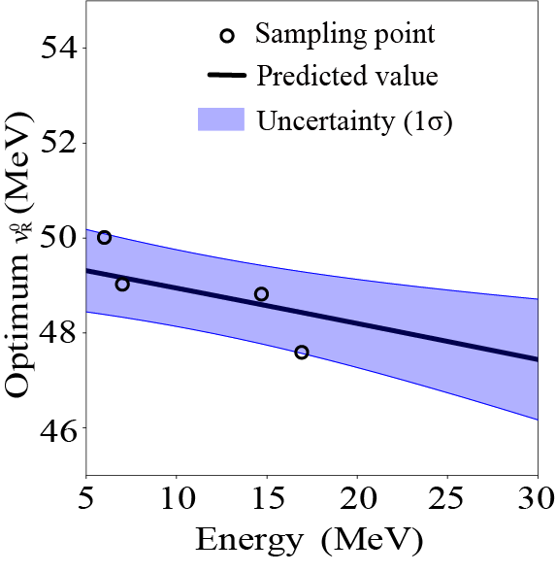
Framework: Research Procedure
☆ Predict the energy dependence of $v_{R}^{0}(E)$ by the following process.
1, Collect the $v_{R}^{0}\left(E\right)$ list
2, Predict the $v_{R}^{0}\left(E\right)$ using ML
Input : Energy (MeV) | Output: $v_{R}^{0}$ (MeV)
6 | 50.0
7 | 49.0
15 | 48.8
17 | 47.6
⇒
7
Notes:
So, just like this.
Final, confirm the prediction accuracy to calculate the cross section using predicted Vr0, and to compare that and experimental data.

Slide 8
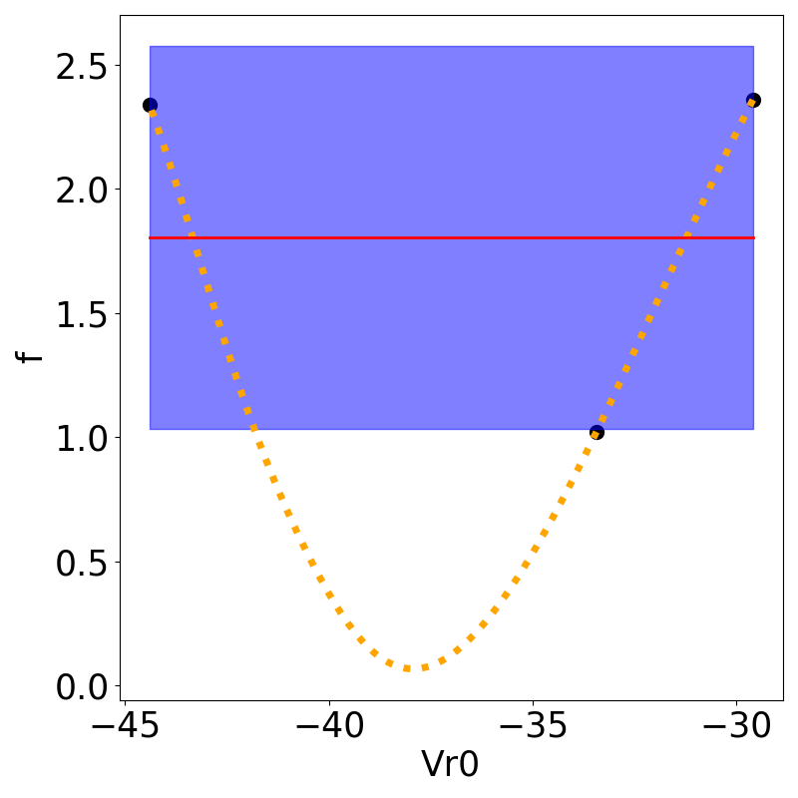
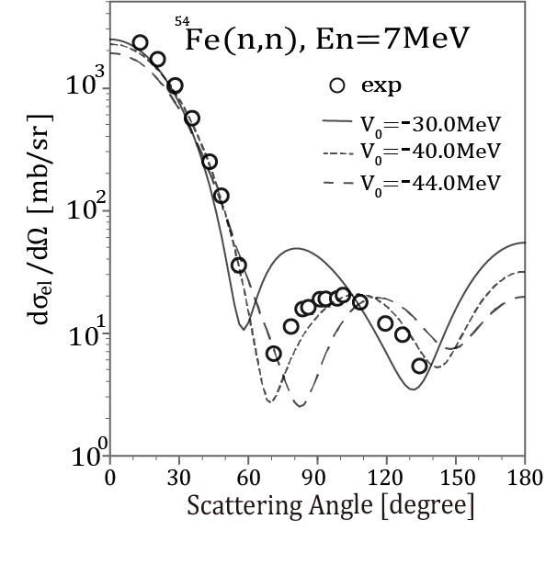
Framework : An Example of optimization by machine learning
Estimate the evaluation function about optical parameter $V_{R}^{0}$ by Gaussian process regression from the sampling results . Calculate the evaluation function for $V_{R}^{0}$, where the large uncertainty and the small predicted value.
n=3
$$V_{R}^{0}$$
$$V_{R}^{0}$$
$$V_{R}^{0}$$
$V_{R}^{0}$ [MeV]
8
Notes:
Maybe, You don’t know my progress and how to collect the optimum vr value using machine learning. So, I’ll show example of optimization shortly.
In this example, we want to optimum value of vr for this experimental value. First, calculate the cross section at Vr chosen randomly and calculate the value of evaluation function at these Vr.
Left figure shows these cross section and exp, and right panel show these evaluation function value.
Next, input the result of Vr and evaluation function value, we predict evaluation function at any Vr using Gaussan process reguression.

Slide 9
Framework : An Example of optimization by machine learning
Estimate the evaluation function about optical parameter $V_{R}^{0}$ by Gaussian process regression from the sampling results . Calculate the evaluation function for $V_{R}^{0}$, where the large uncertainty and the small predicted value.
n=3
$$V_{R}^{0}$$
$$V_{R}^{0}$$
$$V_{R}^{0}$$
$V_{R}^{0}$=-36MeV
$V_{R}^{0}$ [MeV]
9
Notes:
This is result. At right panel, black line is predicted value ,and blue area is prediction error form Gaussian process reguression.
Now, We want to know Vr that mimize the Evaluation function value. Probably, this value is around the point
1: Evaluation function is low
2: error is big
So, the machine learning choose the point match this 2point.
In this example, he choose Vr=-36.0MeV.
So, Next calculate the cross section and evaluation function at -36.0MeV

Slide 10
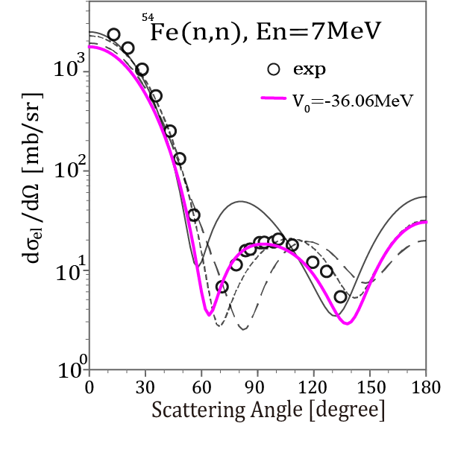
Framework : An Example of optimization by machine learning
Estimate the evaluation function about optical parameter $V_{R}^{0}$ by Gaussian process regression from the sampling results . Calculate the evaluation function for $V_{R}^{0}$, where the large uncertainty and the small predicted value.
n=3
$$V_{R}^{0}$$
$V_{R}^{0}$=-36MeV
$V_{R}^{0}$ [MeV]
10
Notes:
Magenta line and point is this result. Now, we get new training data. So, we update Gaussain process reguression.
We repeat this process until optmum point is clear some extent

Slide 11
Framework : An Example of optimization by machine learning
Estimate the evaluation function about optical parameter $V_{R}^{0}$ by Gaussian process regression from the sampling results . Calculate the evaluation function for $V_{R}^{0}$, where the large uncertainty and the small predicted value.
n=4
$$V_{R}^{0}$$
$V_{R}^{0}$ [MeV]
11

Slide 12
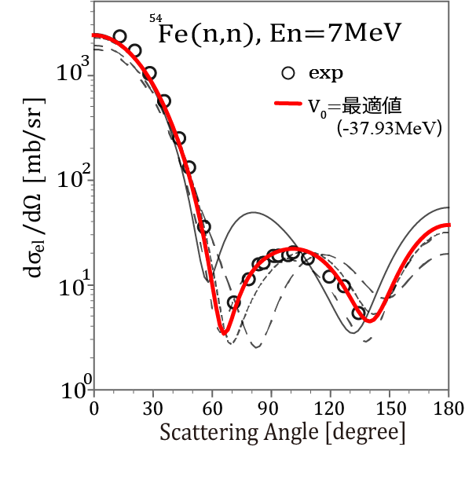
Framework : An Example of optimization by machine learning
Estimate the evaluation function about optical parameter $V_{R}^{0}$ by Gaussian process regression from the sampling results . Calculate the evaluation function for $V_{R}^{0}$, where the large uncertainty and the small predicted value.
n=6
$$V_{R}^{0}$$
optimum
$V_{R}^{0}$ [MeV]
12
Notes:
We repeat this process until optmum point is clear some extent

Slide 13
Framework : Training Data collection
◆ Determine the optimum value of $v_{R}^{0}(E)$ that reproduce experimental data for the angular distribution of ⁵⁸Ni-n elastic scattering.
Details of optimization methods: S. Watanabe et al. J. Nucl. Sci. Technol. 1-8 (2022)
Input : Incident Energy (MeV) | Output: Optimum Value of $v_{R}^{0}$ (MeV)
5 | 50.25
6 | 52.45
7 | 51.25
8 | 41.04
10 | 50.05
12 | 49.16
14 | 48.12
14.7 | 48.49
17 | 46.74
24 | 46.16
13
Notes:
This table shows the data collected in this way. In this example, we focus only anugular distribution of 58Nin-n elastic scattring.
Final, I’ll show the preditcon result using some of these data.

Slide 14
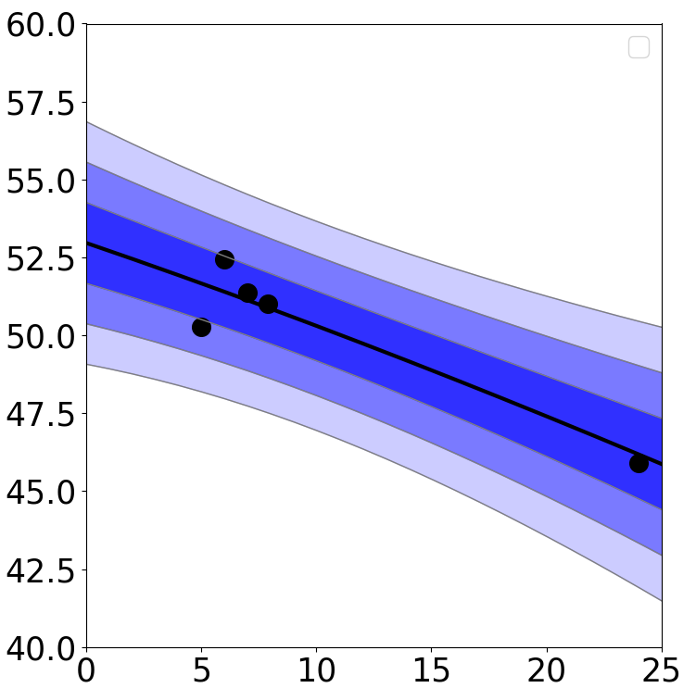
Result: Estimate Optimum value of $v_{R}^{0}(E)$
◆ Estimate the optimum value of $v_{R}^{0}$from Training data using Gaussian process regression.
Input : Incident Energy (MeV) | Output: Optimum Value of $v_{R}^{0}$ (MeV)
5 | 50.25
6 | 52.45
7 | 51.25
8 | 41.04
14
24 | 46.16
×
Gray: Training data
Red: Test data
14
Notes:
We predict the optimum Vr0 at 0~25 MeV using gray data at right table. Left figure is this.
Black dot is traning data, black line is prediction value and 3blue band is prediction eroor of Gaussian process reguression, form inner, 1σ, 2σ,3σ
Confirm the accuracy of this prediction calculate 14MeV, this is black cross point.

Slide 15
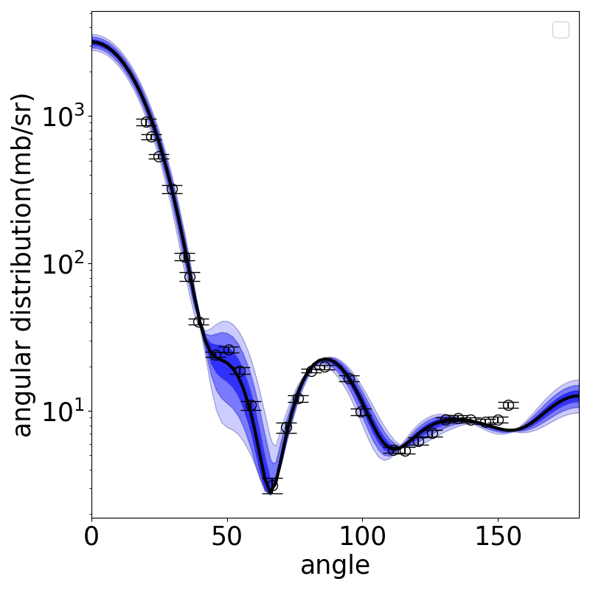
Result: Estimate Optimum value of $v_{R}^{0}(E)$
◆ Estimate the optimum value of $v_{R}^{0}$from Training data using Gaussian process regression.
⁵⁸Ni(n,n),14MeV
×
×
◆ $v_{R}^{0}$ predicted by Gaussian process regression reproduces experimental data for angular distribution of elastic scattering with some degree of accuracy.
15
Notes:
Right figure show calculated corss section, using black croos point, with experimental data. And, I show the area corresponding to left’s blue band, 1σ, 2σ,3σ.
The cross section reproduce the experimatal data with some degree of accuracy, despite not considering the experimental data about 14MeV.
Considering up to error area, almost experimental data are reproduced.

Slide 16
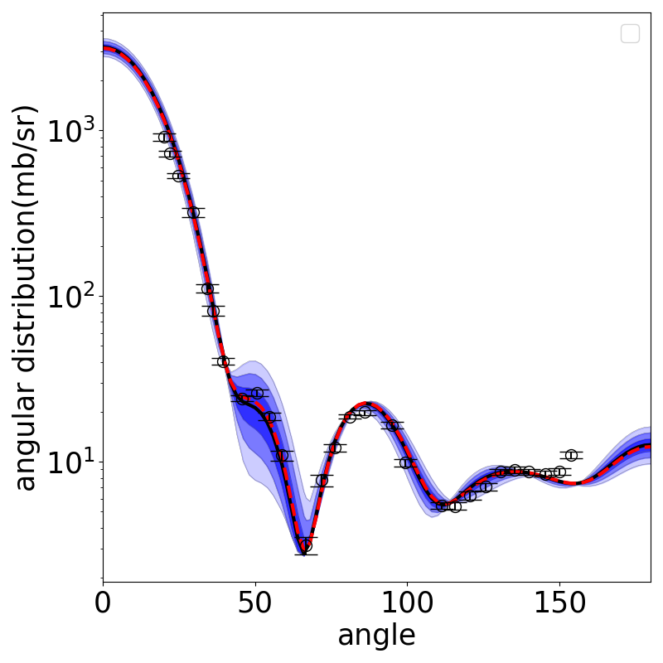
Result: Estimate Optimum value of $v_{R}^{0}(E)$
◆ Estimate the optimum value of $v_{R}^{0}$from Training data using Gaussian process regression.
⁵⁸Ni(n,n),14MeV
×
×
×
×
◆ $v_{R}^{0}$ predicted by Gaussian process regression reproduces experimental data for angular distribution of elastic scattering with some degree of accuracy.
16
Notes:
Last, I’ll show this result in comparison to Kunieda-ssan propesed value Vr.
Red line and red dash line is poropesd one. Vr value is a little different. But, at cross section, this different is very small. Our priditction result is pretty good comparion to proposal value.
We think this mechanism should be enlarged so that nuclear data can be created efficiently.

Slide 17
Summary
◆We calculated the elastic scatterings cross section at arbitrary energies combining machine learning and nuclear reaction model.
◆Using Bayesian optimization, we obtained the optimum depth value of the central force of the optical potential for the experimental data.
◆Using gaussian process regression, we estimated the optimum depth value of the central force of the optical potential at arbitrary energies.
◆Using the optimum value at low and high energy for training data, we can predict elastic scattering cross section at arbitrary incident energy with some degree of accuracy.
17

Slide 18
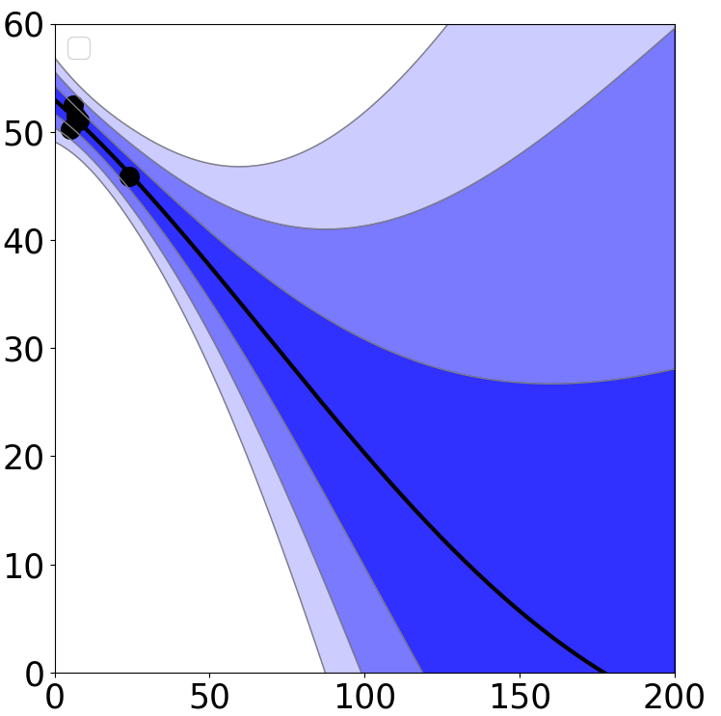
Future works :There are some task for implementation
◆ Extrapolation have big estimation error (characteristic of ML).
◆ Estimate other part of the optical potential (in this presentation, only estimate the depth of central force)
×
◆ More dependencies to be estimated (in this presentation, only estimate energy dependence)
18
Notes:
Last, I speak about task for implementation.
Actually, the last estimate result I showed has a very large error margin at high energies. This is characteristic of ML.
So, we need to solve the problem.
And,~~

