Slide 1
Pre-bunching and re-bunching systems at RAON for nuclear science experiments
Donghyun Kwak, Cheolmin Ham, Kyoungho Tshoo, Seok Ho Moon,
Junyeong Jeong, Gidong Kim, Jangwon Kwon, Garam Hahn,
Woojin Song, Hyung Jin Kim, Taeksu Shin, Chung Moses
2023. 8. 9 Wednesday
A3F-CNS Summer School 2023

Slide 2
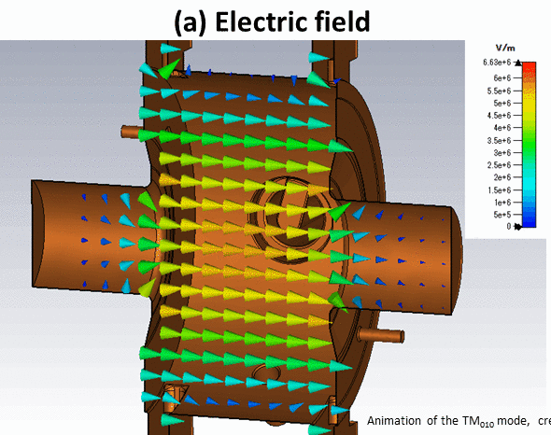
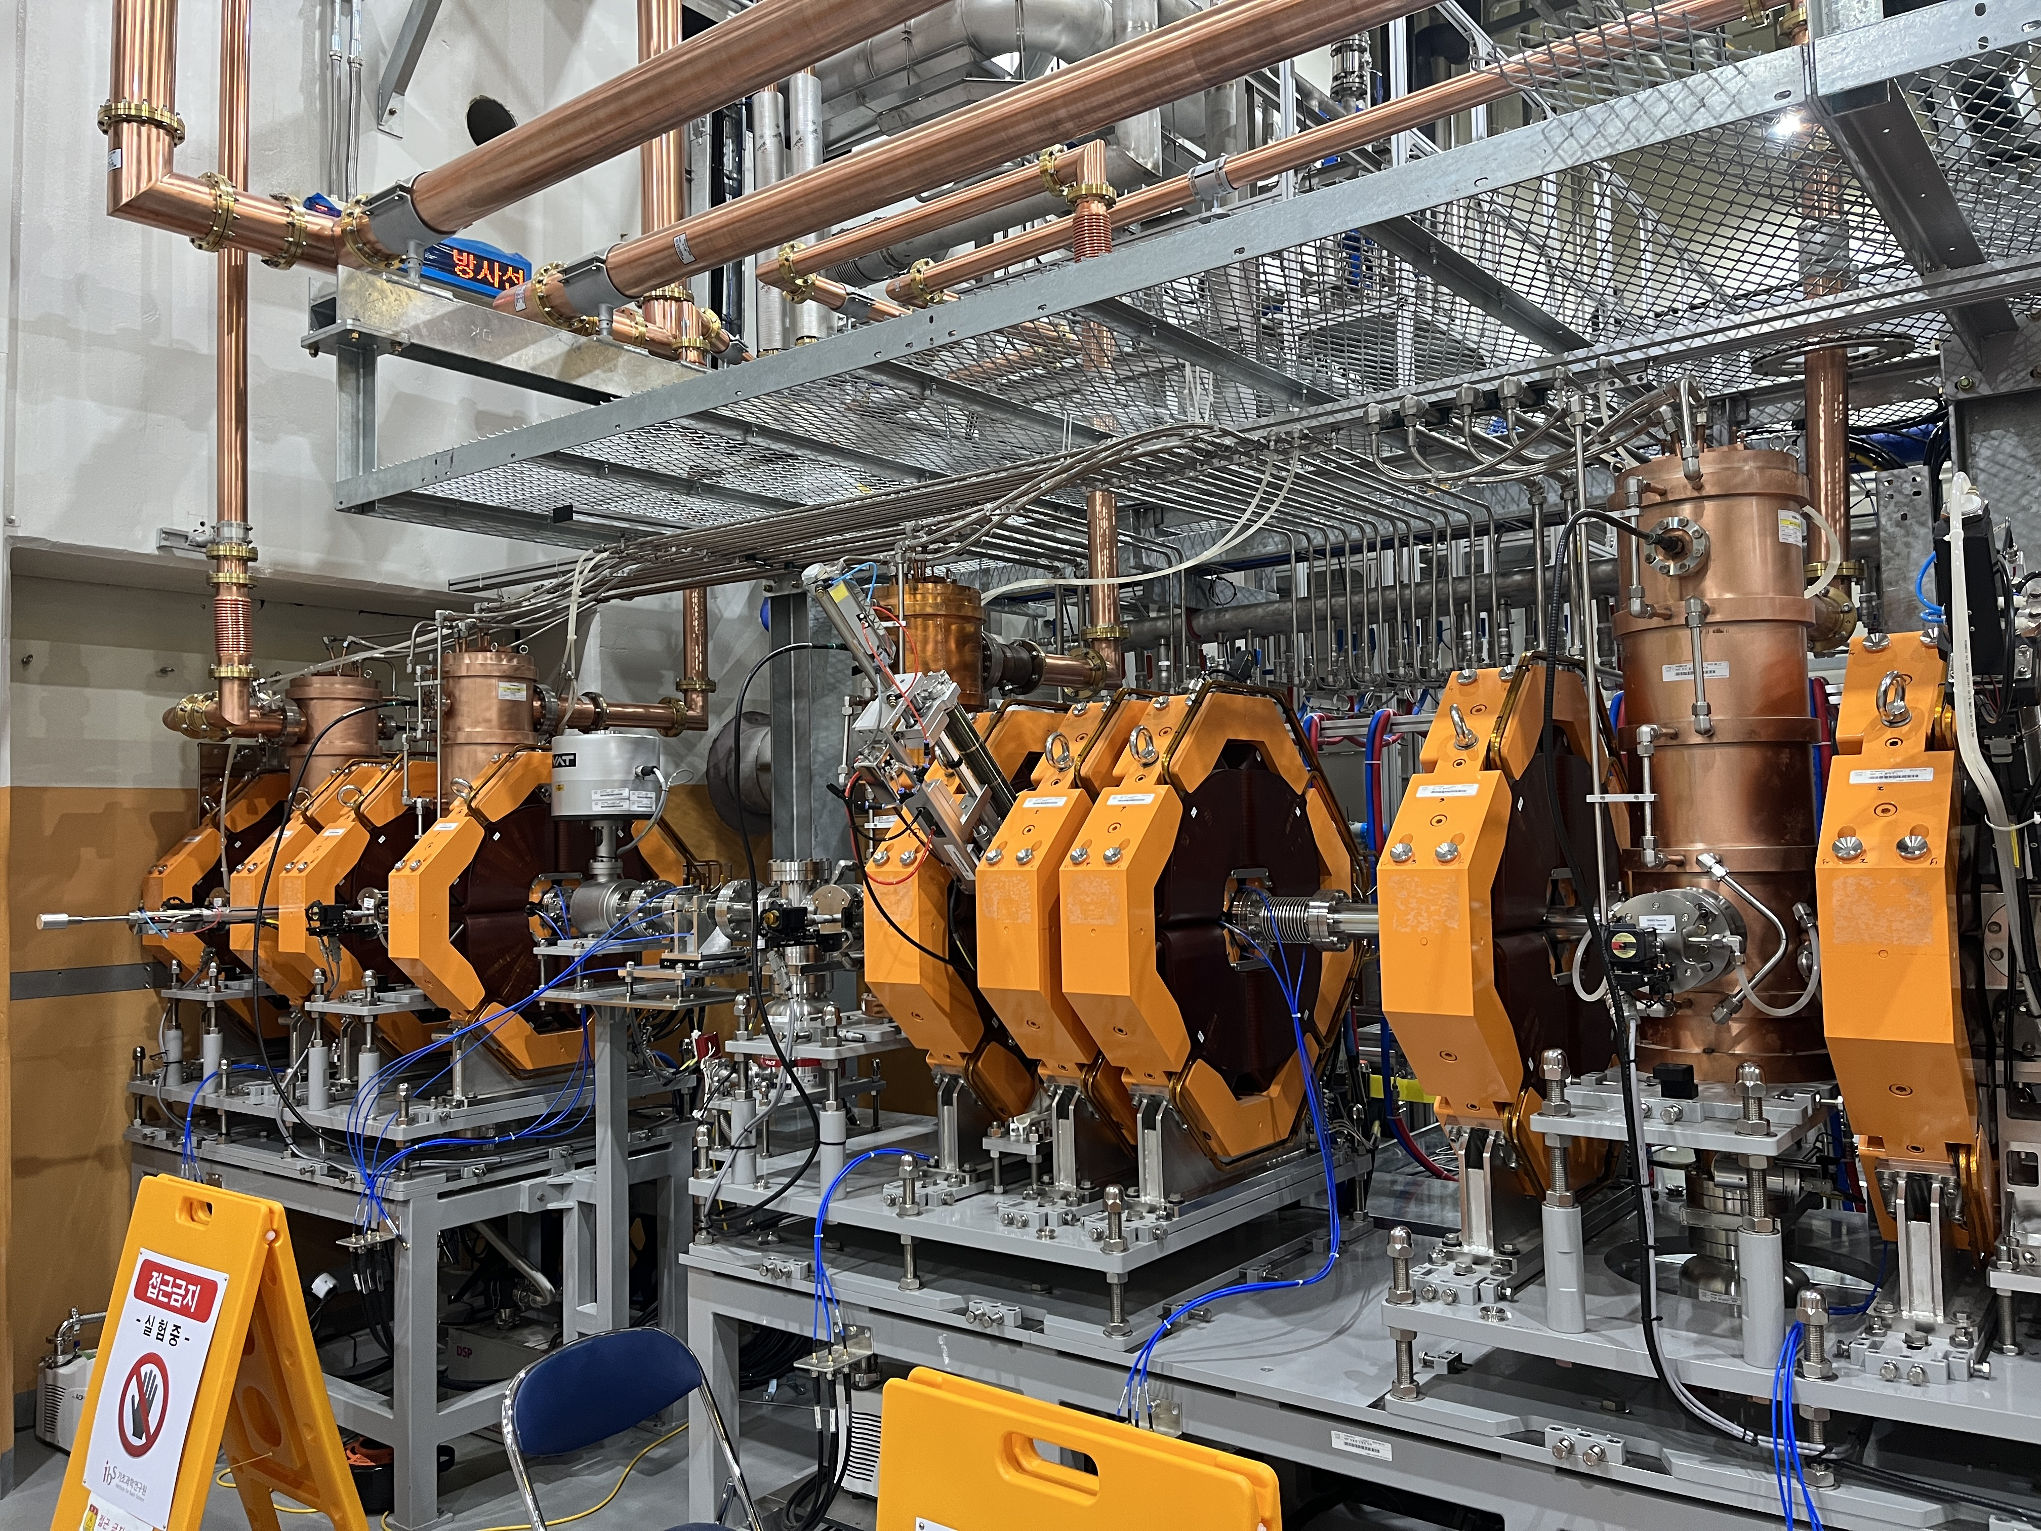
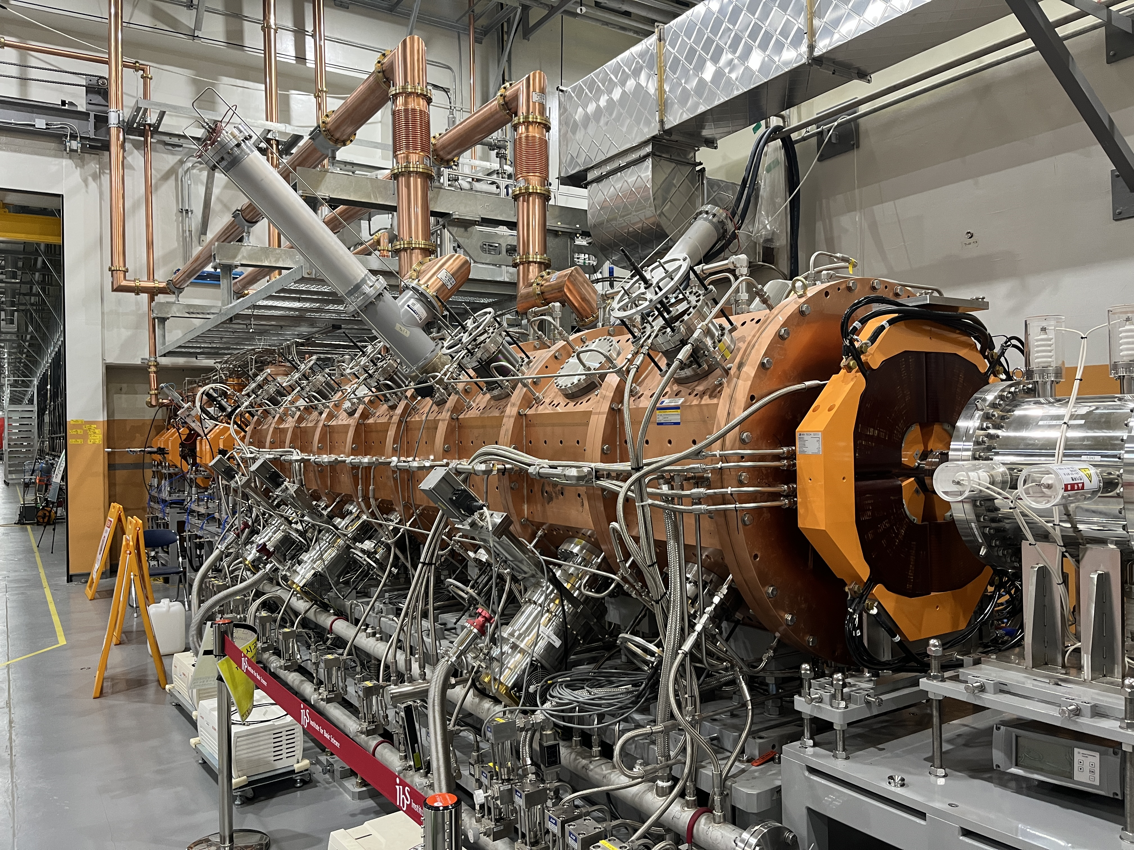
Principle of RF accelerators
Charged Particle
Charged particle beam
RF Wave

Slide 3
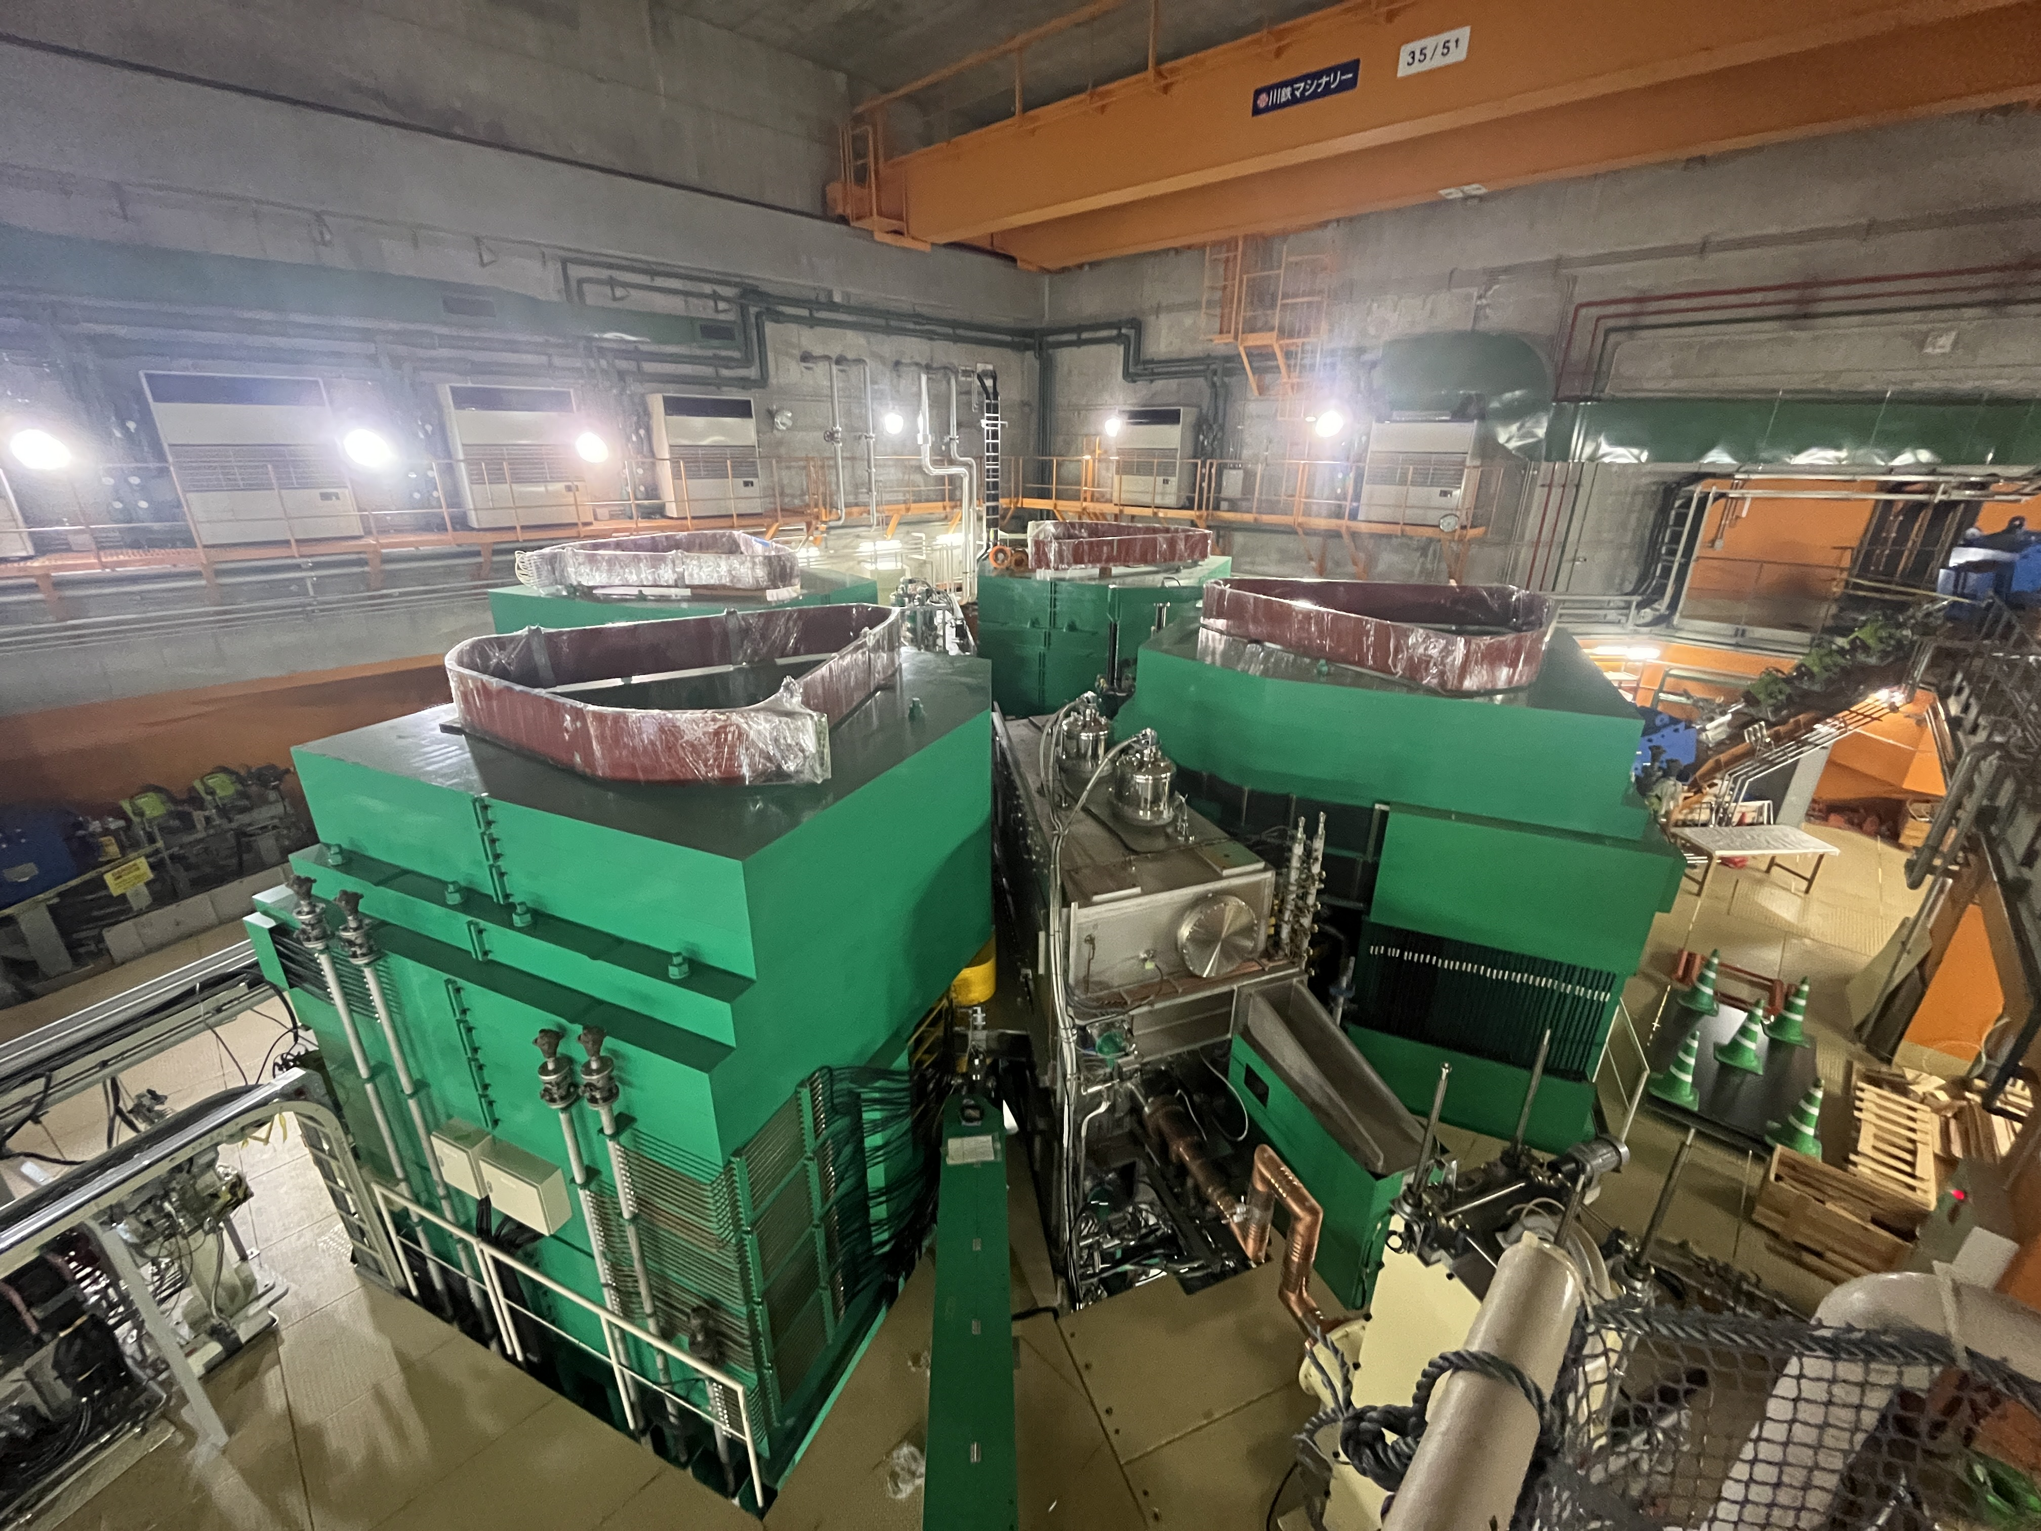
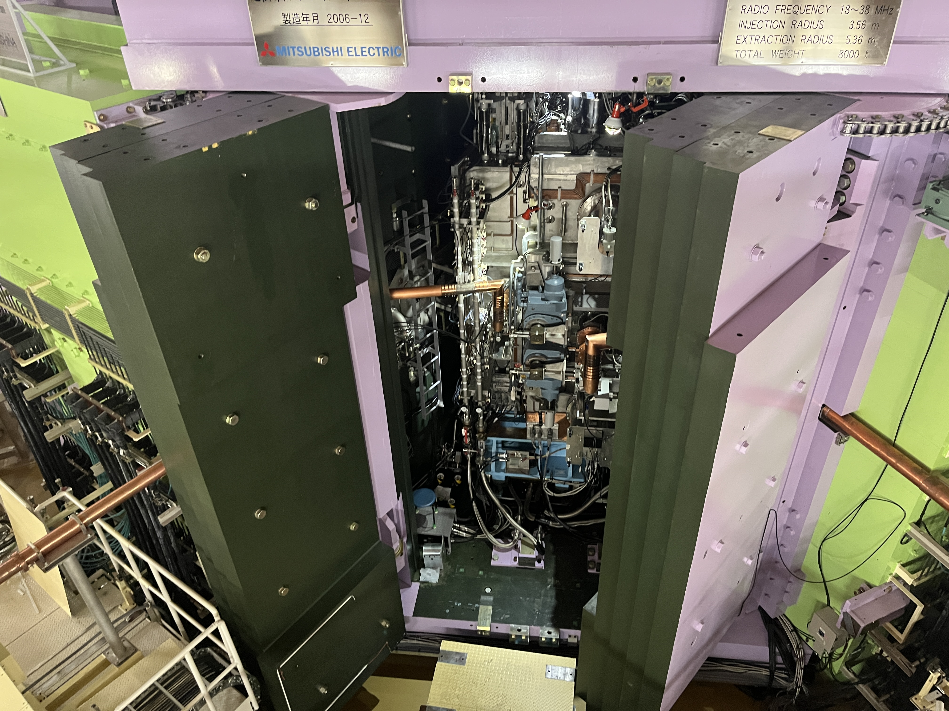
RIKEN superconducting cyclotron

Slide 4
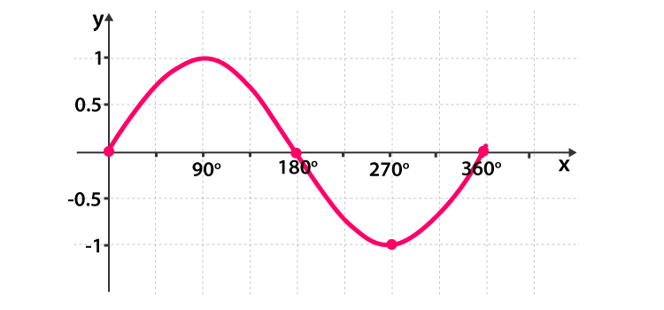
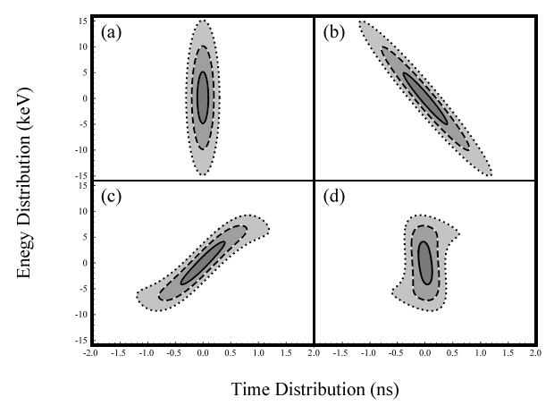
What is Rebunching?
Bunch shape in SCL3-KoBRA beamline
Bunch Tail
Bunch Head
(a) At the end of SCL3, (b) At the entrance of the rebuncher, (c) After the rebuncher, and (d) At KoBRA production target

Slide 5
Pre-Bunching and Re-Bunching System Location
Low energy experimental hall B
SCL2
SCL3
Low energy experimental hall A

Slide 6
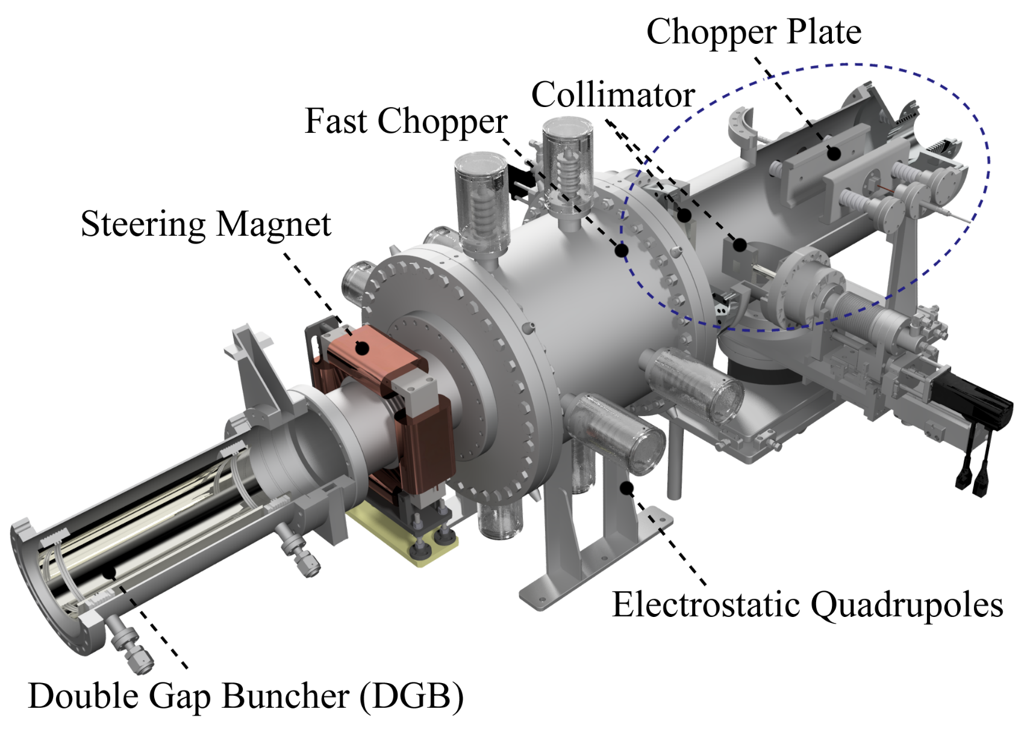
Pre-Bunching System
Ion Beam
In order to make TOF (Time-of-Flight) experiments possible in low-energy experimental facilities, it is necessary to reduce the repetition rate and bunch length of the beam. To achieve this, we have installed a pre-bunching system in the LEBT (Low Energy Beam Transport) line.

Slide 7
Basic Concept of Fast Chopper
Initial Energy : 10keV/u
Deflection Plate Length : 250mm
Deflection Plate
Ion Beam
Collimator

Slide 8
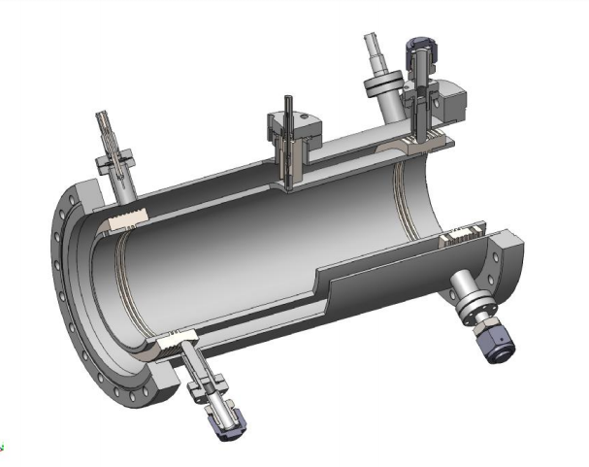
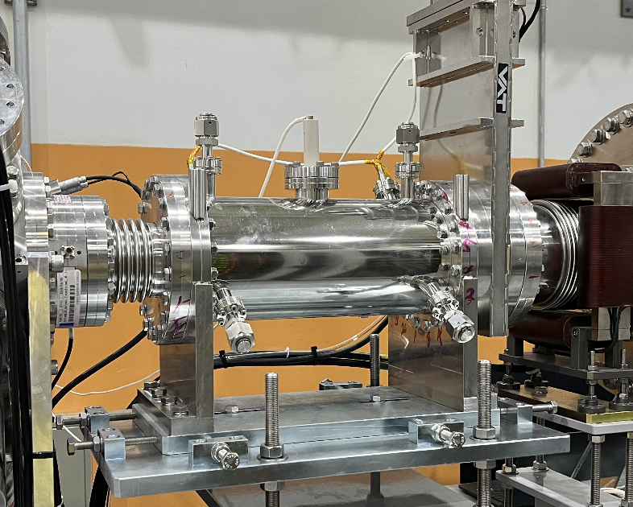
Basic Concept of Double Gap Buncher (DGB)
DGB Schematic
RF(2MHz, Max 2500V, in case of the argon beam)
Ground
electrode
Central electrode
Ground
electrode
10mm
10mm
270mm ($=βλ∗\frac{0.8π}{2π}−2∗5mm)$
Simulated by SIMION code

Slide 9
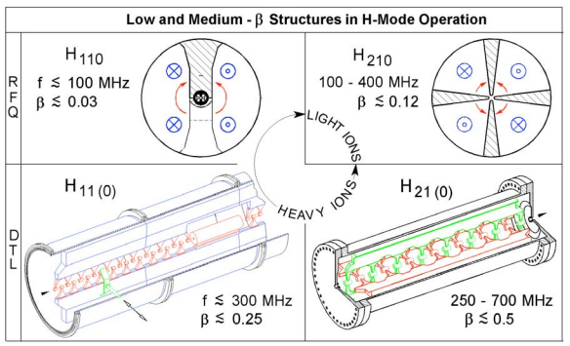
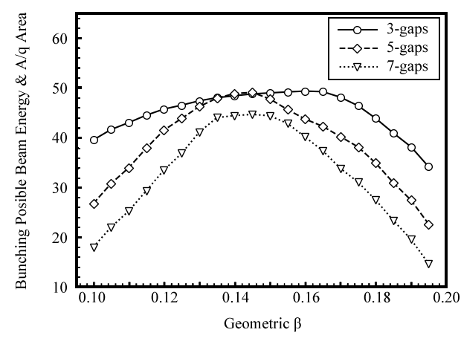
Rebuncher Optimization
Cavity frequency: 162.5 MHz
Normal conducting rebuncher
Beam with β < 0.1774
RMS RF power: up to 20 kW
IH-DTL has been selected

Slide 10
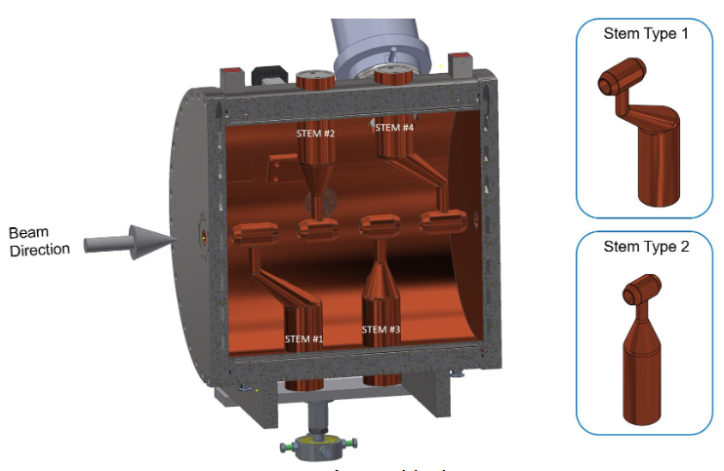
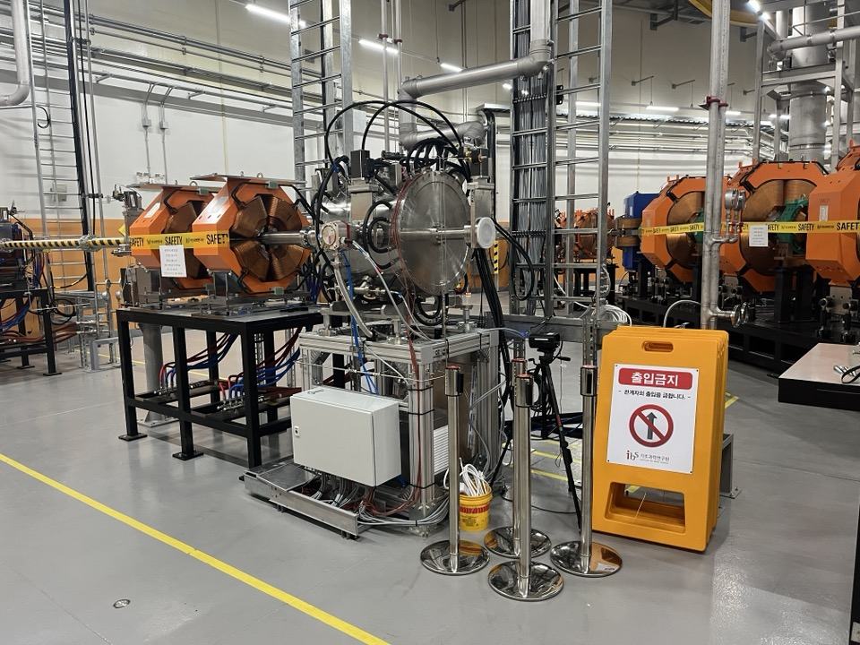
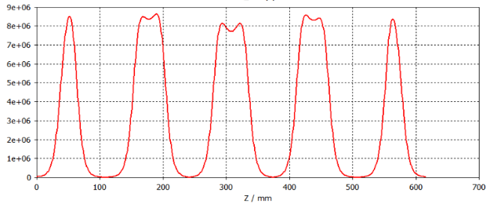
Rebuncher

Slide 11
Thank you!

