Slide 1
Investigation of single-particle and collective behaviour in K-isotopes
The 22th CNS International Summer School (A3F-CNSSS23)
By
ROZINA RAHAMAN
Under the supervision of Dr. ABHIJIT BISOI
Department of Physics
IIEST, Shibpur, West Bengal, India

Slide 2
Outline of the talk
Introduction
Why ^{38,40}K?
Experimental Details
³⁸K
⁴⁰K

Slide 3
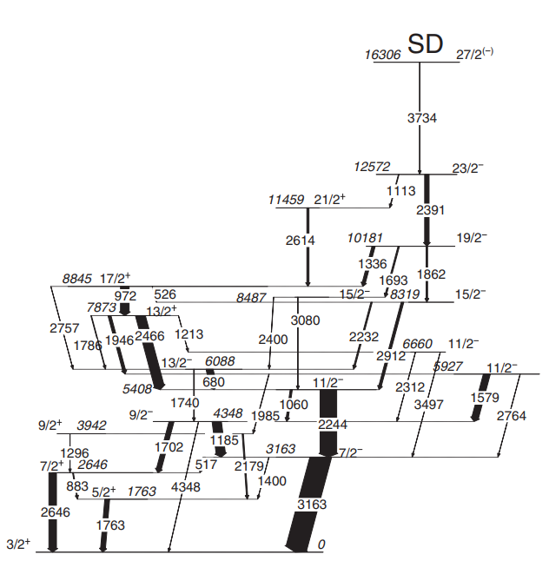
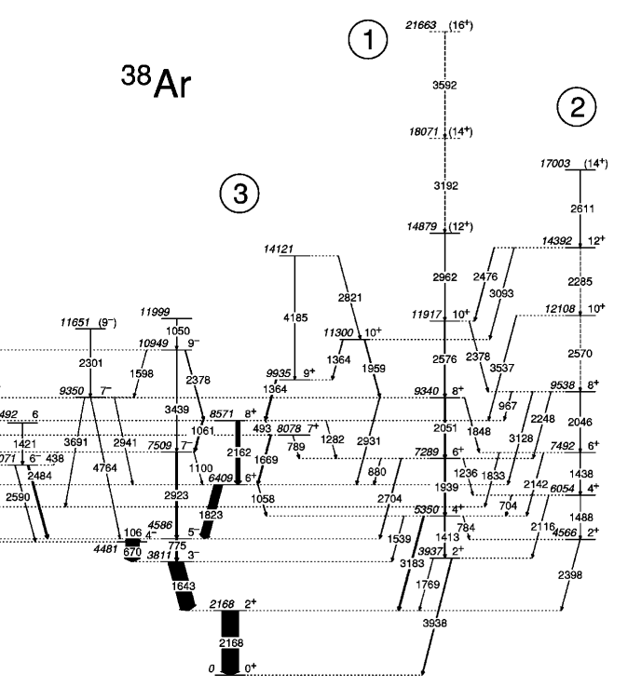
Introduction
Ref: PRC 88, 34303 (2013)
PRC 65, 034305 (2002)

Slide 4
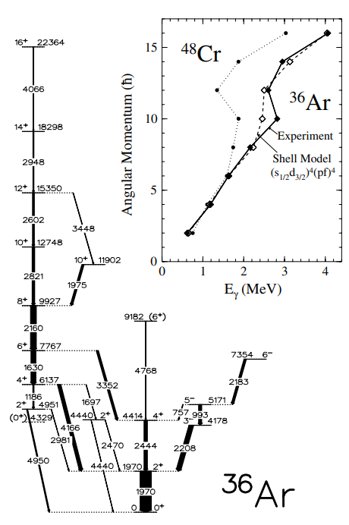
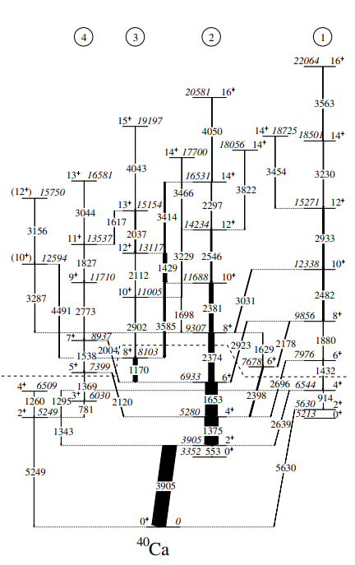
PRL 85, 2693 (2000)
PRL 87, 222501 (2001)

Slide 5
Why ^{38,40}K ?
A~40 region gives us an opportunity to investigate experimentally the interplay between single-particle and collective-mode excitations and interpret them theoretically by using large-basis shell-model calculations.
³⁸K (Z = N = 19) and ⁴⁰K (Z = 19, N = 21) are the odd-odd nuclei in this mass region.
³⁸Ar is the isobaric partner nucleus of ³⁸K. It shows two normal deformed bands, which are generated from 4p-4h excitation.
⁴⁰Ca is the isobaric partner nucleus of ⁴⁰K. It shows a superdeformed band, which is generated from 8p-8h excitation.
We also expect collective excitations at higher excitation energy in ³⁸K and ⁴⁰K, generated from multi-particle multi-hole excitations.

Slide 6
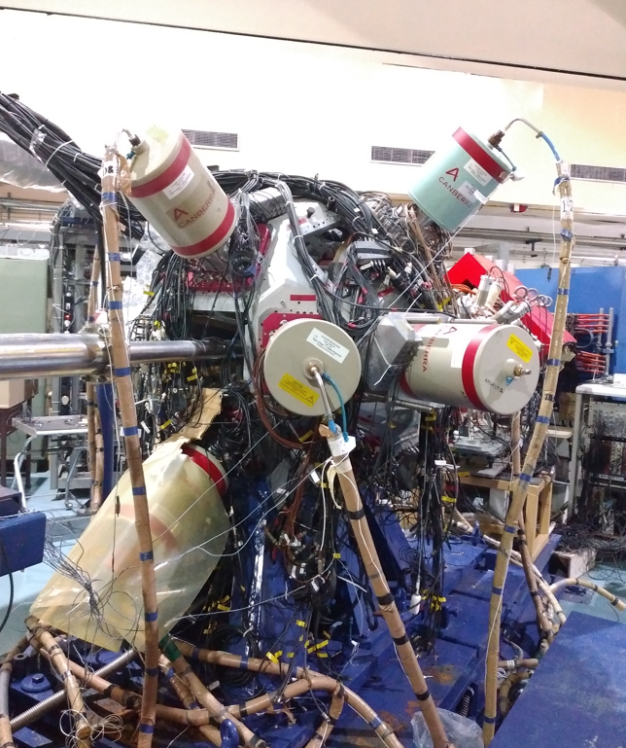
Experimental Details
First experimental details
Beam: ²⁸Si
Target: ¹²C (50 μg/cm²)
Backing – ¹⁹⁷Au (18 mg/cm²)
Beam Energy: 110 MeV
Beam & Target
Detectors
13 Compton-suppressed clovers were mounted at five different angles, i.e., 148⁰ (4), 123⁰(2), 90⁰(4), 57⁰(2), and 32⁰(1) with respect to the beam axis.
INGA-IUAC detector setup
Beam – ¹⁹F
Target – ²⁷Al (0.43 mg/cm²)
Backing – ¹⁹⁷Au (11.4 mg/cm²)
Beam Energy – 68 MeV
12 Compton-suppressed clovers were mounted at four different angles, i.e., 148⁰ (4), 90⁰(4), 57⁰(1), and 32⁰(3) with respect to the beam axis.
Beam & Target
Detectors
Second experimental details

Slide 7
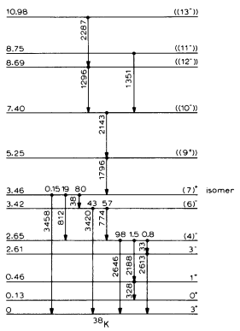
³⁸K
³⁸K has been substantially investigated through proton-, deuteron-, and alpha-induced reactions but there are few experiments where heavy ions were used.
The ³⁸K nucleus was previously studied by C. J. van der Poel et al.

Slide 8
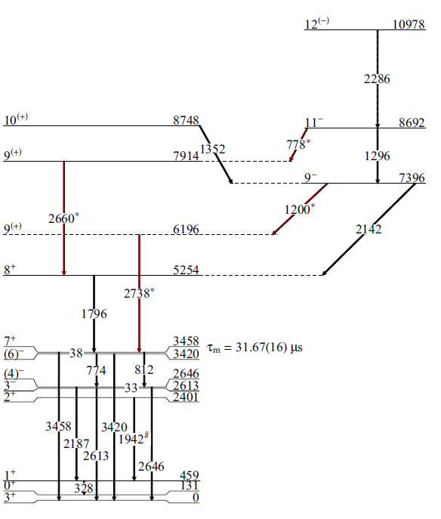
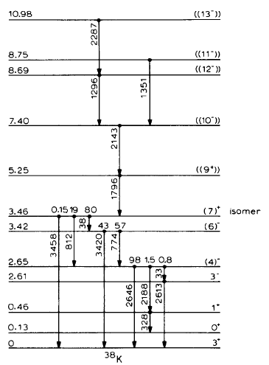
Previous level scheme of ³⁸K
Final level scheme of ³⁸K

Slide 9
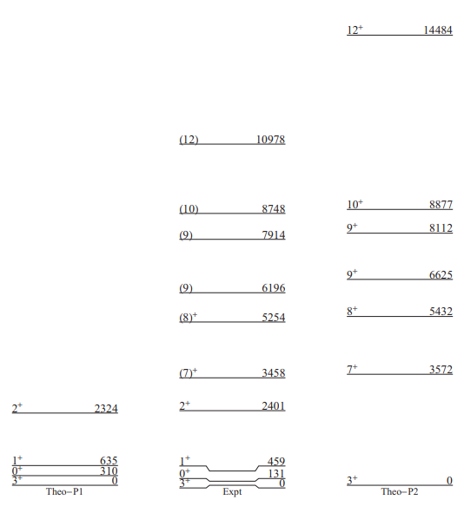
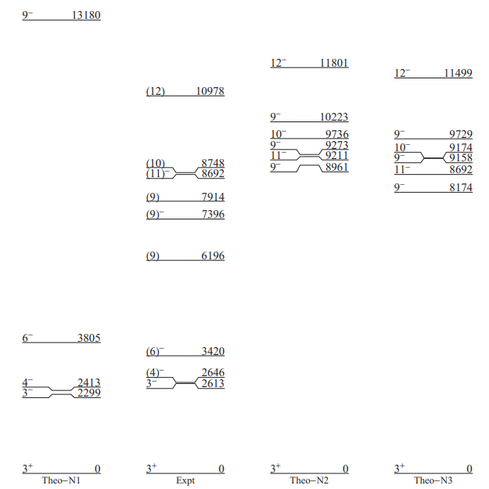
Theoretical Calculation
Positive parity states
Large basis shell model (LBSM) calculation have been performed using the code OXBASH in order to understand the microscopic origin of each excited levels of ³⁸K .
Core: ¹⁶O.
Valance particle : 22.
Model space: sdpf .
Interaction : sdpfmw.
The valance space consists of 1d_{5/2,} 1d_{3/2,} 2s_{1/2 ,}1f_{7/2,} 1f_{5/2,} 2p_{3/2 ,} 2p_{1/2} for both protons and neutrons.
Negative parity states

Slide 10
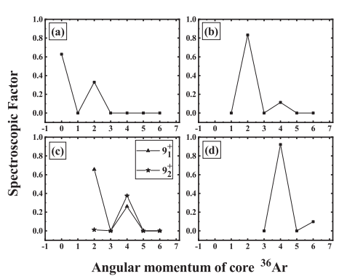
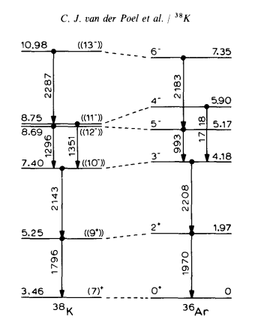
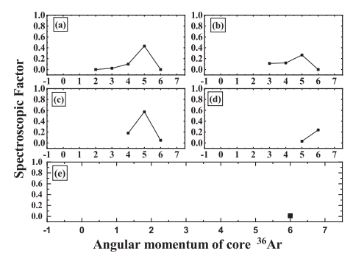
Two-nucleon transfer spectroscopic factor calculation
7⁺
8⁺
10⁺
9⁻
10⁻
11⁻
12⁻
13⁻

Slide 11
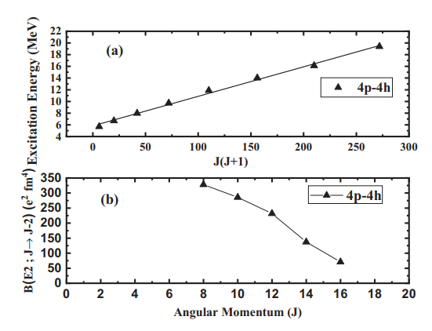
Prediction of deformed band in ³⁸K
We have extended our theoretical investigation by using 4p-4h excitations to search for collectivity in ³⁸K.
The deformation parameter (β) for the B(E2) value 328 e²-fm⁴ (8⁺ → 6⁺) is 0.38 . Estimated major-to-minor axis ratio (X) is 1.42 for β = 0.38.
These values are comparable to the observed deformation in ⁴⁰Ca, ³⁶Ar, and ³⁵Cl.
Therefore, our calculations provide a strong indication of the presence of a deformed band at higher excitation energies in ³⁸K.

Slide 12
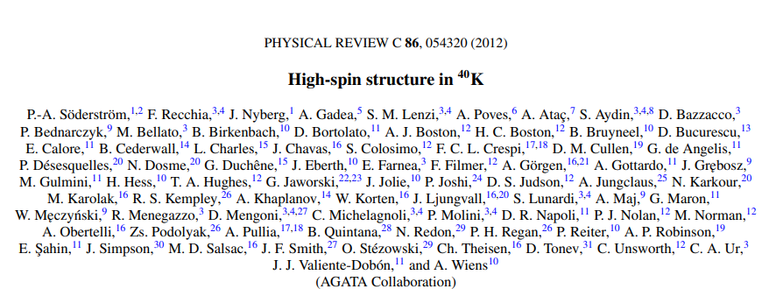
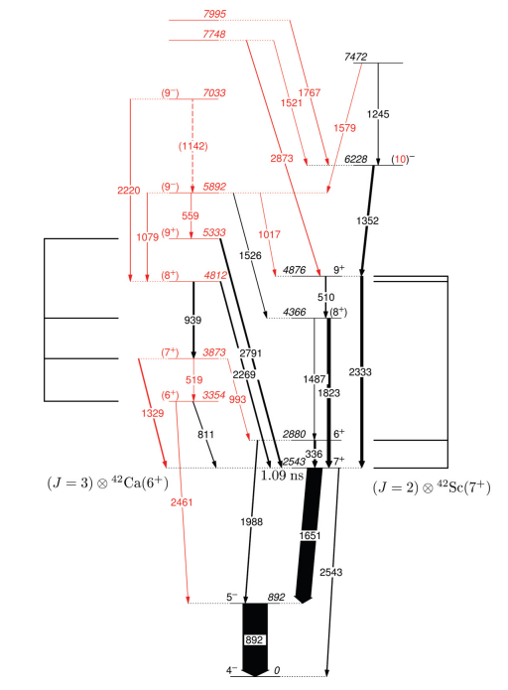
⁴⁰K
The ⁴⁰K nucleus was previously studied by P.-A. Soderstrom et. al.
High-spin states of ⁴⁰K have been populated in the fusion-evaporation reaction ¹²C(³⁰Si,np) ⁴⁰K.

Slide 13
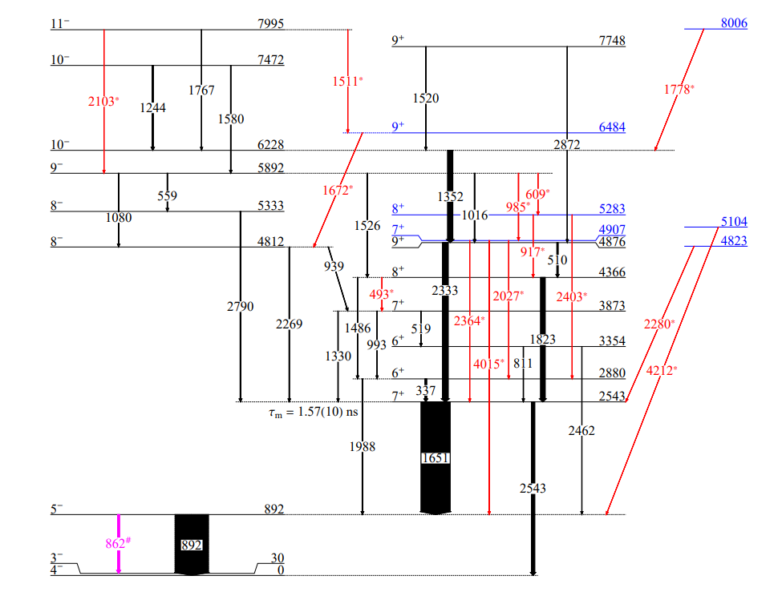
Final level scheme of ⁴⁰K
Previous level scheme of ⁴⁰K

Slide 14
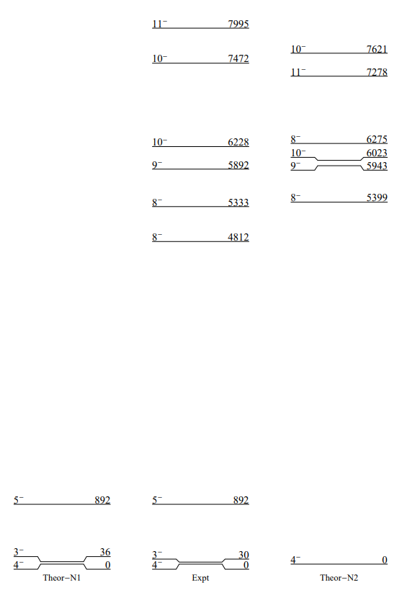
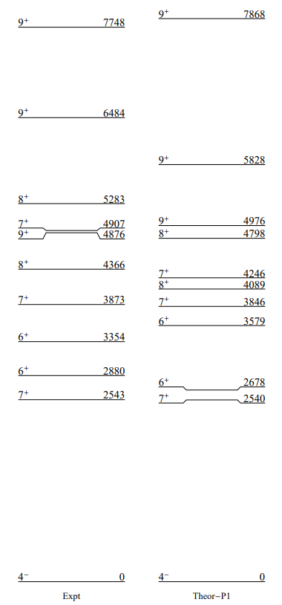
Theoretical Calculation
Positive parity states
Negative parity states

Slide 15
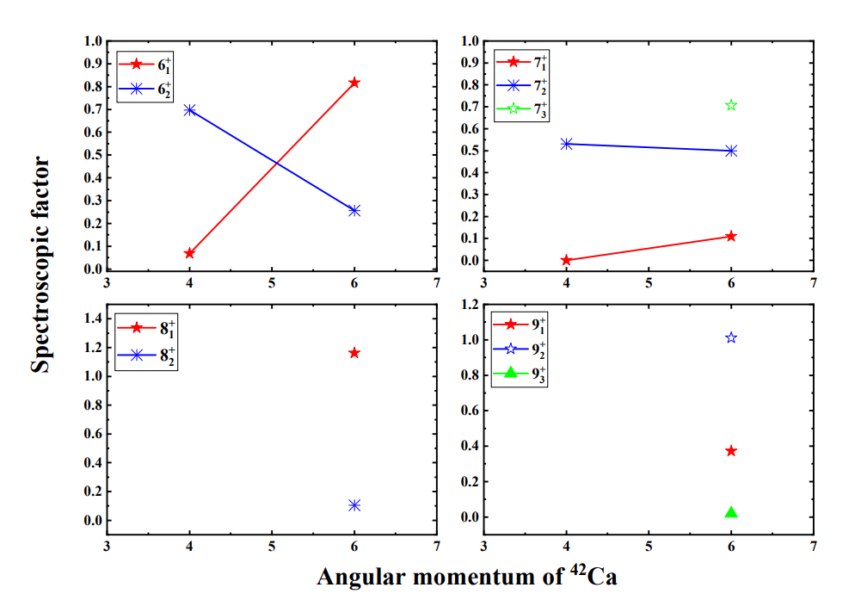
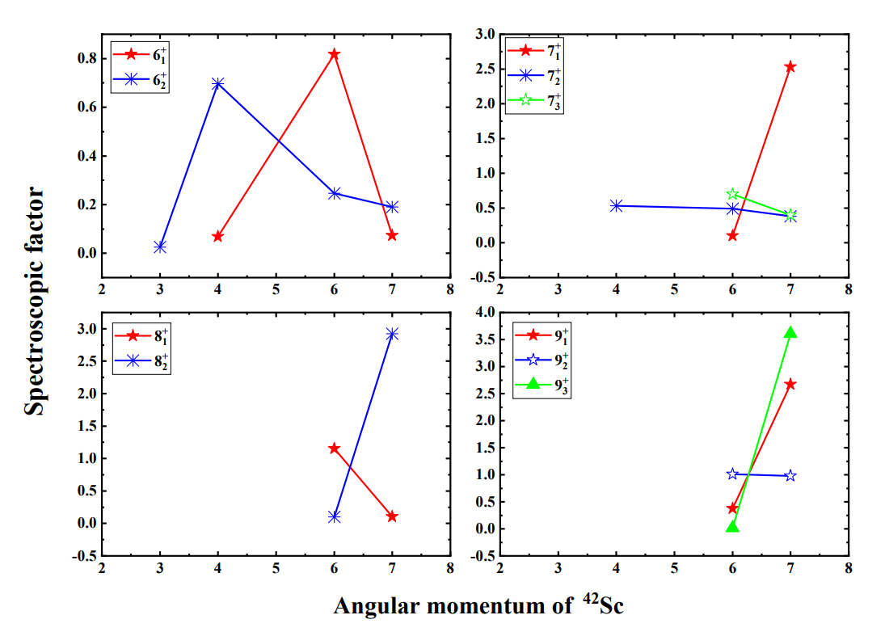
Two-nucleon transfer spectroscopic factor calculation

Slide 16
Conclusion
We have added 4 new transitions and 2 new levels above the isomer in the existing level scheme of ³⁸K. Our current work identifies 14 new transitions and 6 new levels in ⁴⁰K.
The R_{DCO}, R_{ADO} and linear polarization measurements were carried out to assign / confirm / modify the spin and parity of the levels for both nuclei.
In our present work, we have measured the mixing ratio of most the transitions for the first time.
LBSM calculations have been performed using the code OXBASH to understand the microscopic origin of each excited state in ³⁸K and ⁴⁰K.
Two-nucleon transfer spectroscopic factor calculations have been carried out for a few levels of interest in these nuclei to understand the spectroscopic co-relation with the levels in the neighboring nuclei (A±2).
Evolution of collectivity with angular momentum has also been studied in terms of particle partitions of the levels. Based on the theoretical analysis, we have predicted the presence of a deformed band at the higher excitation energies in ³⁸K.

Slide 17
Acknowledgement
I would like to thank Prof. Abhijit Bisoi for his fruitful suggestions and encouragement. I am extremely grateful to Prof. Eiji Ideguchi for providing the information about this school and conveying my details to the organizing committee. I would like to express my deep gratitude towards my institute IIEST, SHIBPUR and CNS SUMMER SCHOOL 2023 organizers for providing the financial support.

Slide 18
THANK YOU

